Slide 1
Habu Project 1:
Optimal Marketing Mix and Budget Optimization
Group 6
Rayan Elatmani, Yining Liang, Yichen Pan, Celine Yao, Cindy Yu

Slide 2
Research Objectives
Apply, fine tune and compare different marketing mix models to obtain one that is best suited for informing advertising strategies on Amazon.
Find out the effectiveness of various digital marketing channels in driving sales.
Devise the optimized budget allocation to maximize ROI given an advertising budget.

Slide 3
Data
Analysis of aggregate data sourced from Amazon Marketing Cloud
Daily data from seven brands spanning a duration of 12.5 months
One dataset on sales and converted users for each brand
One dataset on spend and user reach of six media channels (i.e. display, sponsored products, sponsored brands, sponsored display, videos, OTT) for each brand

Slide 4
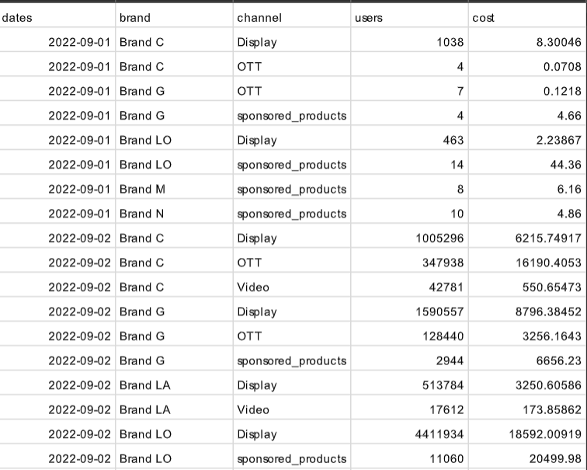
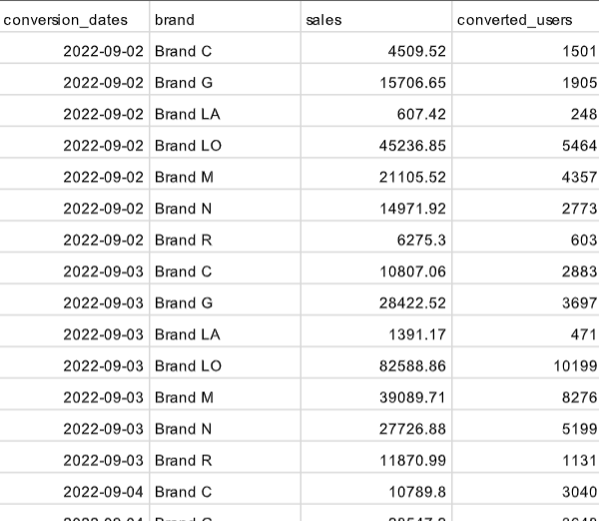
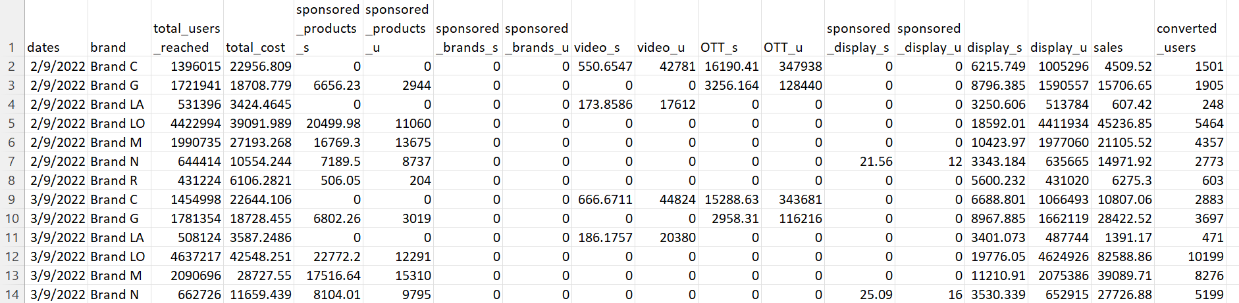
Methods
Data Preprocessing
Merge the two datasets provided by Habu into a dataframe in a format that can be used for further analysis
+

Slide 5
Methods
Exploratory Data Analysis
Simple descriptive statistics and data visualizations
Calculate simple ROI for all brands combined and individual brands
Run multiple linear regression models
Marketing Mix Models
Build a Marketing Mix Model with Google’s LightweightMMM for all brands combined and for individual brands
Build a Marketing Mix Model with Robyn (from Meta) for all brands combined and for individual brands
Notes:
Exploratory Data Analysis
Simple descriptive statistics and data visualizations to -
Identify any obvious trends and patterns in the relationships between the various variables
Identify any common patterns across brands
Inform subsequent model specifications
Calculate simple ROI for all brands combined and individual brands
Run multiple linear regression models to -
Identify the relationships between sales and the various media channels
Identify any common patterns across brands
Inform subsequent model specifications
Marketing Mix Models
Build a Marketing Mix Model with Google’s Lightweight for all brands combined and for individual brands
Organize data as inputs to the model
Use spending on each media channel as predictors of sales
Check data quality (correlation matrix, variances, spend fractions, variance inflation factors) to see if any variables need to be removed
Choose which functions to use (hill adstock, adstock or carryover) to account for carry-over effects and diminishing returns of advertising
Account for seasonality and weekday
Train the models and select the best performing model
Analyze existing effectiveness and contribution of various media channels for potential reallocation
Run budget optimization with the best model to obtain optimized budget allocation, controlling for how much initial allocation can change
Build a Marketing Mix Model with Robyn (from Meta) for all brands combined and for individual brands
Organize data as inputs to the model
Use spending on each media channel as predictors of sales
Apply geometric adstock transformation to account for carry-over effects of advertising
Apply saturation transformation to account for diminishing returns of advertising
Use Meta’s time-series forecast package Prophet to account for trend, season, holiday and weekday
Train the models and select the best performing model
Analyze existing effectiveness and contribution of various media channels for potential reallocation
Apply budget allocator to the best model to obtain optimized budget allocation, controlling for how much initial allocation can change

Slide 6
Methods
Comparison
Compare the performance and results of LightweightMMM and Robyn
Use performance metrics (in-sample fit and out-sample prediction) to compare their predictive power
Compare interpretability
Identify any common/different conclusions on effectiveness of various channels and budget optimization
Summarize findings and insights and develop recommendations
Evaluate and propose areas for further research

Slide 7
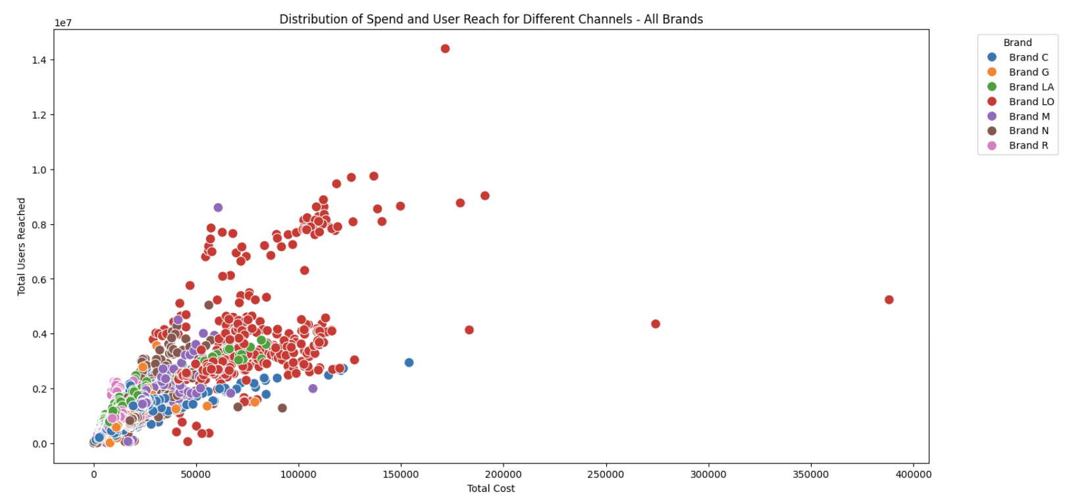
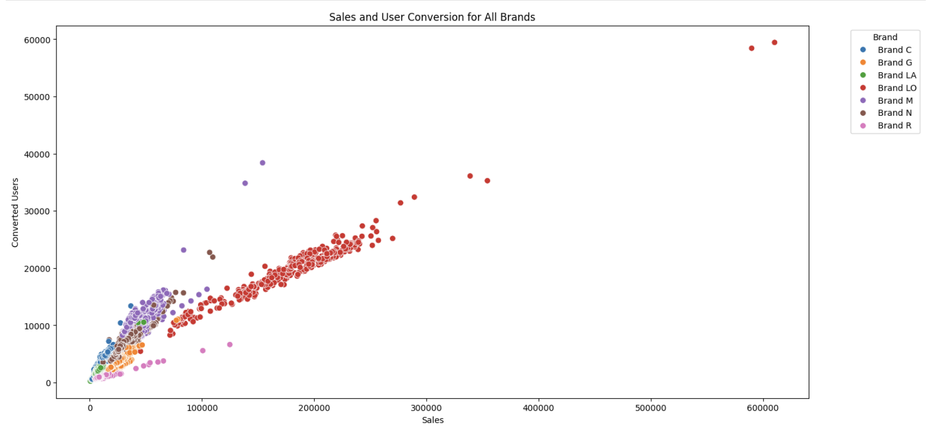
Findings & Insights -
Exploratory Data Analysis
Two measures of media channels which can be used as inputs/independent variables: spend & user reach
Two key performance indicators can be used as dependent variable: sales & user conversion
From scatterplot, determine which one to include in our models. From the top diagram,
Spend vs User Reach
No clear relationship and pattern varies across brands
Depend on which media channels each brand spends on
Choose to use spend in our models since it is more directly controlled by companies
the bottom diagram,
Sales vs User Conversion
Highly linear relationship
Using either indicator would likely generate similar results
Choose to use sales in our models as it is what most companies ultimately aim to maximize
We chose spend as independent variable and sales as dependent variable.
Notes:
There are two measures of media channels which can be used as inputs/independent variables, namely spend and user reach of each channel; and two key performance indicators which can be used as the dependent variable, namely sales and user conversion. We therefore look at the relationship between these variables and exercise our business judgment to decide which ones to include in our models.
In the top diagram, where we have plotted user reach against spend for all the brands, we can see that the points are rather spread out and the pattern varies across different brands, possibly depending on which media channels they spend on and how cost is calculated for the respective channels (e.g. cost per thousand impressions, cost per click, etc.). For a more consistent approach in estimating our models for the different brands, we have chosen to use spend on the various media channels as the independent variables since it is more directly controlled by companies as opposed to user reach.
The bottom diagram shows a highly linear relationship between sales and user conversion, which means that our model would likely generate similar predictions and recommendations regardless of which key performance indicator we use as the dependent variable. That said, we have decided to use sales as this is what most companies ultimately aim to maximize.
We chose spend as independent variable and sales as dependent variable.

Slide 8
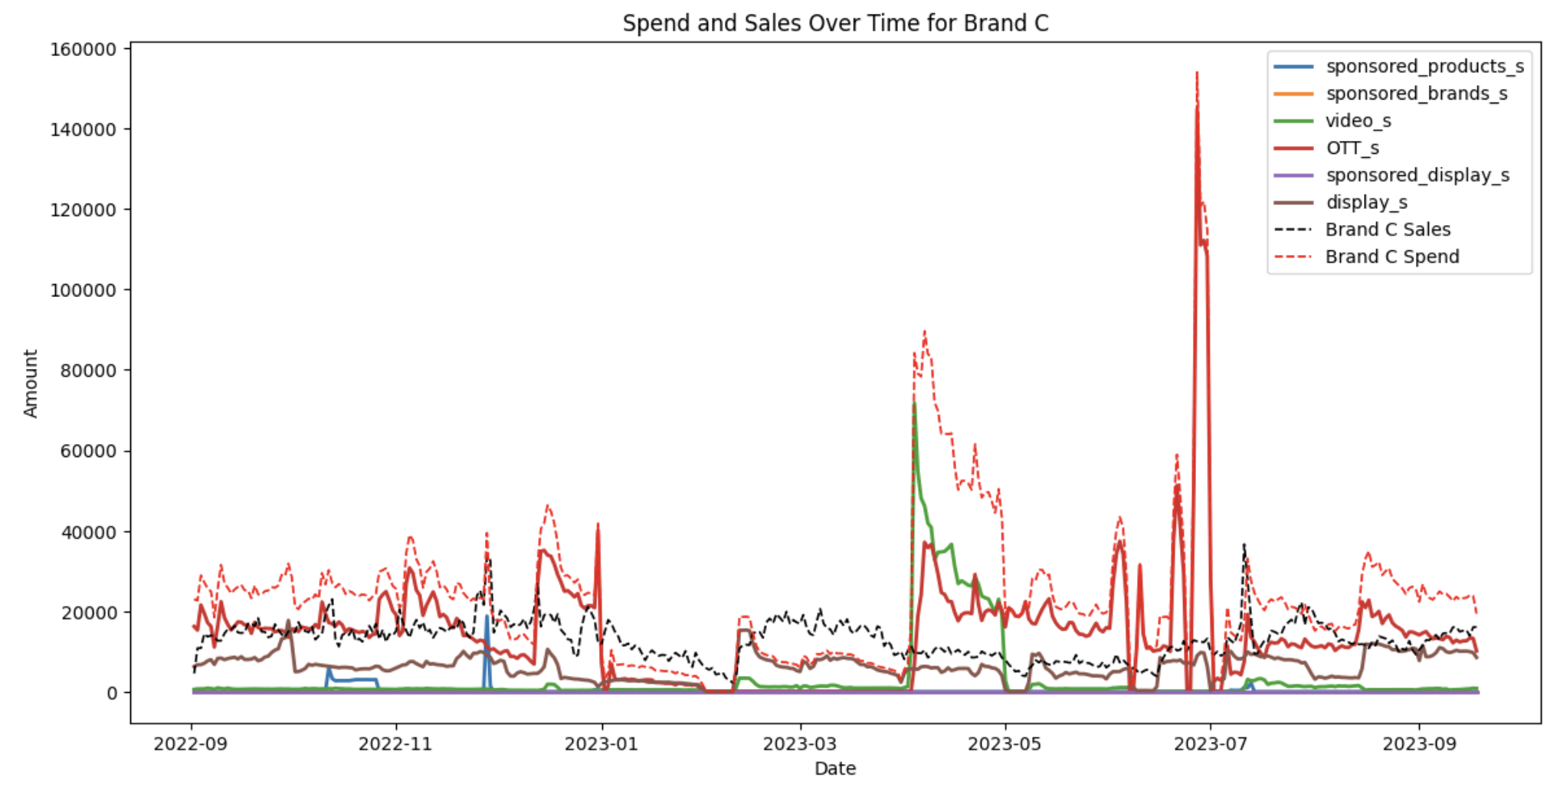
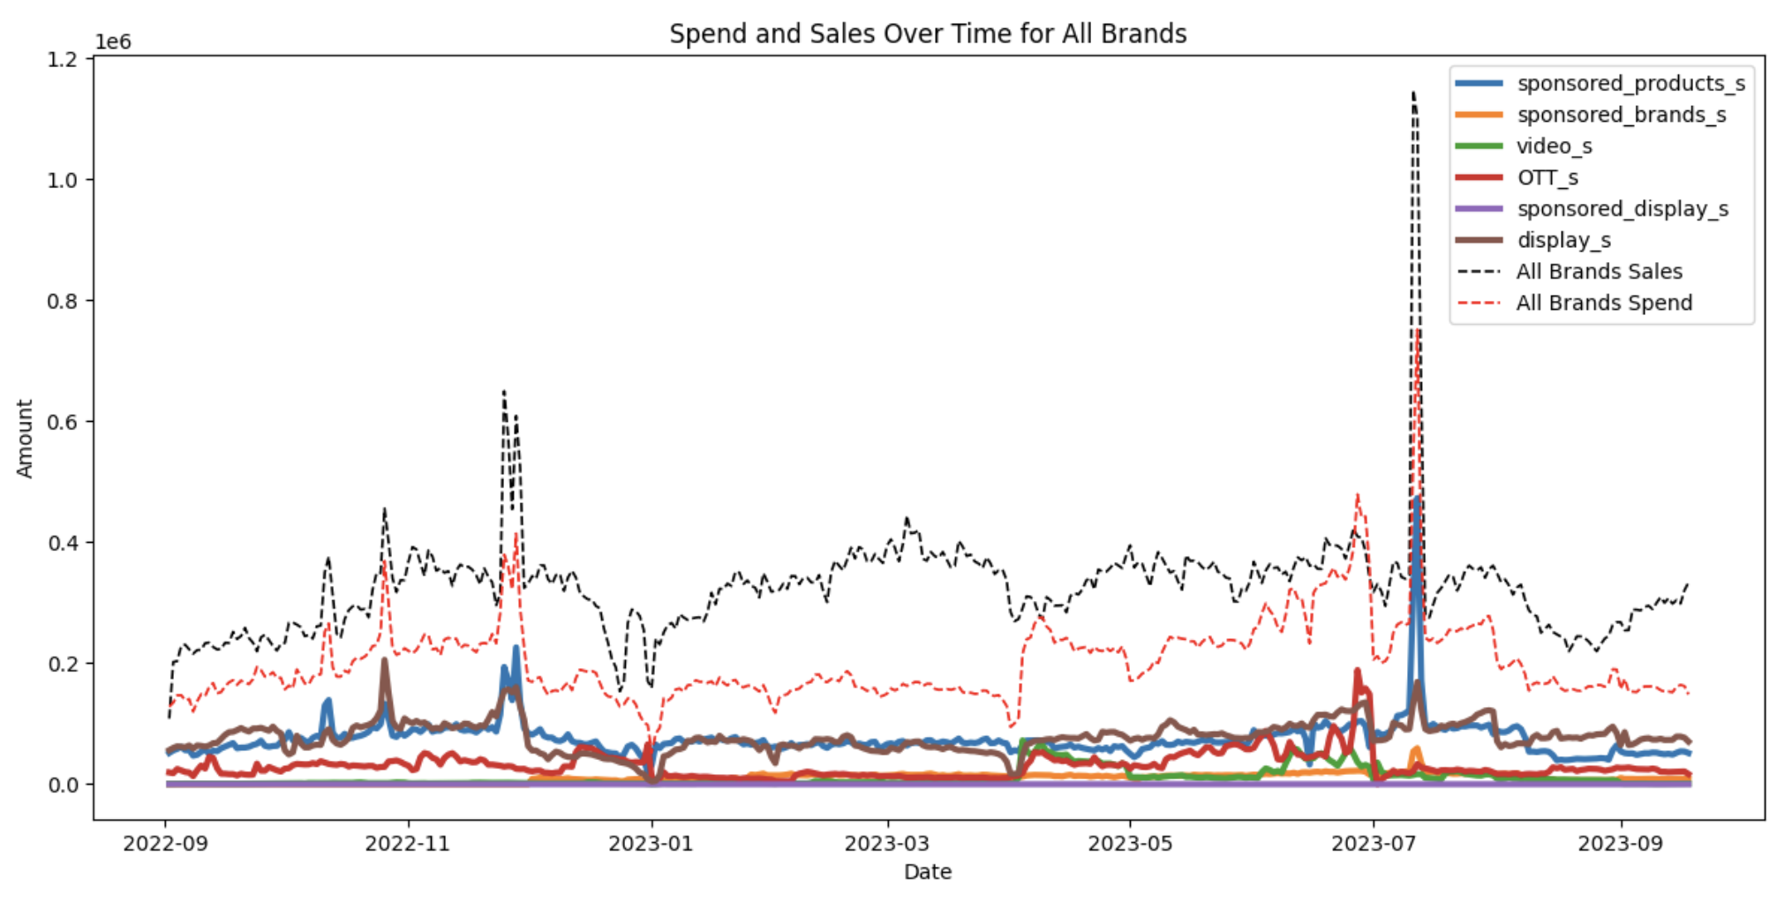
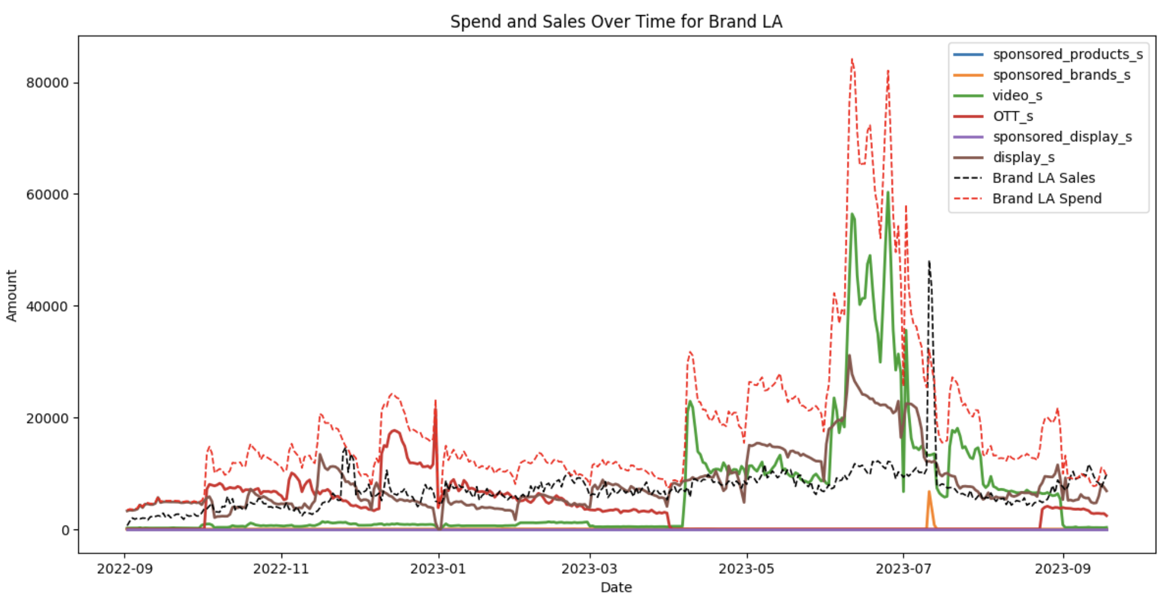
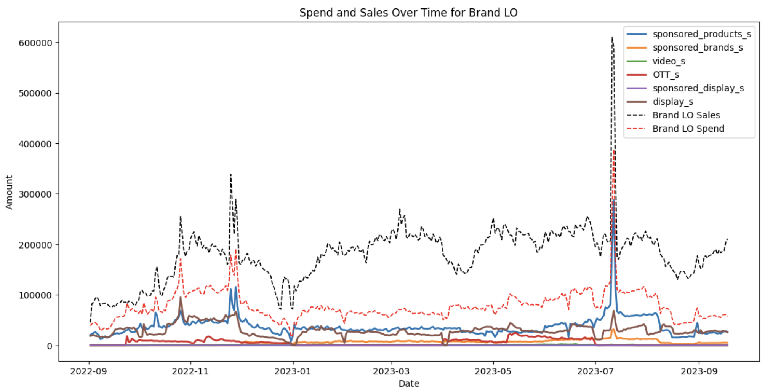
Findings & Insights -
Exploratory Data Analysis
plot total sales and advertising spend over time， sales follow closely with the spend on sponsored products, but less so with the spend on display or video
Brands C and LA (negative ROI)
Spends significantly exceed sales
Spend mainly on video, OTT and display, which have no apparent relationship with sales
Brands LO (Highest ROI)
Very healthy gap between sales and spends
Spend mainly on sponsored products and display - former’s pattern resembles that of sales
Total sales and advertising spend generally exhibit similar trends over time
Sales have a more similar pattern to spend on some media channels (e.g. sponsored products) than others (e.g. display or video)
Notes:
When we plot total sales and advertising spend over time, it can be seen that they generally exhibit similar trends and patterns but not all the time, so there must be other factors other than advertising spend that are affecting sales. It can also be seen that sales have a more similar pattern to the spend on some media channels than others. For instance, sales follow closely with the spend on sponsored products, but less so with the spend on display or video.
The relationship between sales and spend also vary across brands. Here we look at three of them - Brands C and LA, which have negative ROIs; and brand LO, which has the highest ROI. For brands C and LA, we can see that their advertising spends significantly exceed sales. They spend mainly on video, OTT and display, which have no apparent relationship with sales. A reassessment of the marketing approach for these brands may be needed. For brand LO, there is a very healthy gap between sales and advertising spends. It spends mainly on sponsored products and display, the former of which has a pattern that resembles that of sales. This may indicate that sponsored products may be the main advertising channel driving sales.

Slide 9
Findings & Insights -
Exploratory Data Analysis
The main differences between brands with negative or close to zero ROIs and the other brands can be seen in their respective fractions of spend in sponsored products, sponsored brands, video and OTT.
 | All Brands | Brand C | Brand G | Brand LA | Brand LO | Brand M | Brand N | Brand R
Sponsored products | 36.84% | 0.91% | 50.17% | 0.00% | 47.53% | 52.85% | 25.01% | 1.86%
Sponsored brands | 5.1% | 0.00% | 6.87% | 0.19% | 7.68% | 5.76% | 5.59% | 0.31%
video | 4.93% | 12.92% | 0.00% | 35.44% | 0.51% | 0.00% | 0.44% | 0.00%
OTT | 14.85% | 60.16% | 6.96% | 18.55% | 6.66% | 0.70% | 7.03% | 37.29%
Sponsored display | 0.01% | 0.00% | 0.05% | 0.00% | 0.00% | 0.00% | 0.04% | 0.00%
display | 38.28% | 26.01% | 35.95% | 45.82% | 37.62% | 40.69% | 34.90% | 60.55%
ROI | 60.67% | -45.19% | 63.99% | -61.43% | 130.44% | 64.28% | 51.36% | 1.22%
brands with negative or close to zero ROIs (i.e. brands C, LA and R) spend negligible amounts on sponsored products and sponsored brands and instead spend mostly on video and OTT. On the other hand, brands with positive ROIs all spend considerable amounts on sponsored products and some amounts on sponsored brands. They also tend to spend nothing on video and only small amounts on OTT. Consistent with our findings in the previous slide, it is likely that sponsored products is the main media channel that has the greatest effect on sales.
Notes:
The table shows the fractions of spend on the various media channels across brands and how they may relate to the respective brands’ ROIs. Some observations include -
Overall, ROI is 60.67% for all brands combined, suggesting that advertising campaigns are profitable on average. Sponsored products and display are the two channels that brands spend the most on.
All brands spend a considerable amount on display, but almost nothing on sponsored display.
The main difference between brands with negative or close to zero ROIs and the other brands can be seen in their respective fractions of spend in sponsored products, sponsored brands, video and OTT. Specifically, it can be seen that brands with negative or close to zero ROIs (i.e. brands C, LA and R) spend negligible amounts on sponsored products and sponsored brands and instead spend mostly on video and OTT. On the other hand, brands with positive ROIs all spend considerable amounts on sponsored products and some amounts on sponsored brands. They also tend to spend nothing on video and only small amounts on OTT. Consistent with our findings in the previous slide, it is likely that sponsored products is the main media channel that has the greatest effect on sales.

Slide 10
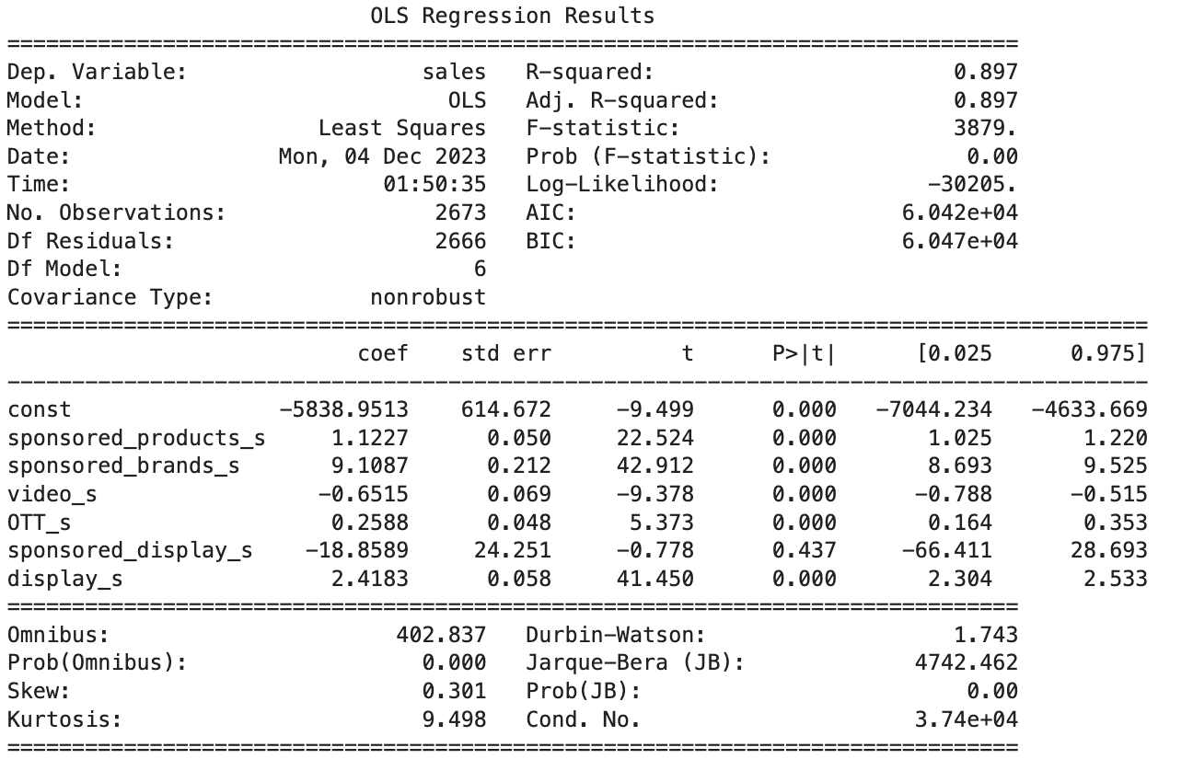
Findings & Insights -
Regression Results
Overall, the linear regression model is statistically significant and has a pretty high R square value in explaining the variance in sales.
coefficients on the media channels, it can be seen that sponsored brands have the largest positive effect on sales, followed by display and sponsored products. It is noted that video has a slight negative association with sales, while the coefficient on sponsored display is insignificant.
apply the marketing mix models to better inform advertising strategies.
Notes:
We further explore whether the relationship between spending on the various media channels and sales by running a regression of sales on spend.
Overall, the linear regression model is statistically significant and has a pretty high R square value of 0.897 in explaining the variance in sales. Looking at the magnitudes of the coefficients on the media channels, it can be seen that sponsored brands have the largest positive effect on sales, followed by display and sponsored products. It is noted that video has a slight negative association with sales, while the coefficient on sponsored display is insignificant.
The above offers some insights into which media channels may contribute more to sales. Obviously, the regression results would only indicate any linear relationship but would not have taken into account any carryover or saturation effects of advertising. Therefore, we would have to apply the marketing mix models to better inform advertising strategies.

Slide 11
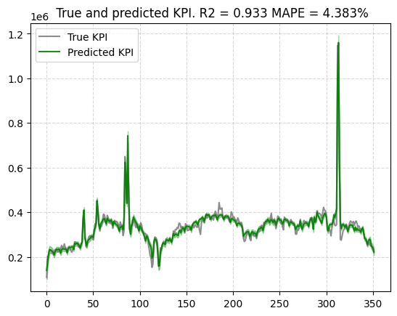
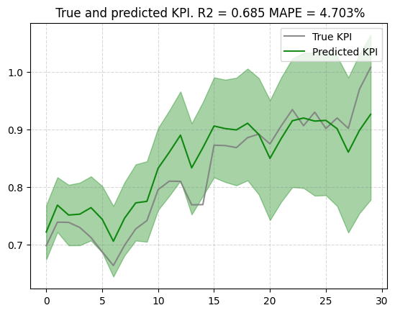
Findings & Insights -
LightweightMMM: Model Training
Applying hill adstock transformation produces the best model fit
Dropped sponsored display as an input channel
Notes:
We tried using applying different functions to transform the media data, namely adstock, hill adstock and carryover, and found that hill adstock generally gives us the best model performance in terms of fit and prediction. Intuitively, this makes sense because hill adstock accounts for both the carry over effect of advertising over time as well as the diminishing returns of advertising spend.
To further improve model performance, we decided to remove sponsored display as an input channel due to the fact that it has high variance, it only accounts for a negligible fraction of total advertising spend, and it is negatively correlated with spending on all other channels as well as sales.
Overall, we were able to achieve an R square value of 0.933 and a mean absolute prediction error (MAPE) of 4.383% on the training set, and an R square value of 0.685 and a mean absolute prediction error (MAPE) of 4.703% on the test set.
It is worth noting that using the adstock function gives us a better R square of value of 0.815, but a worse MAPE of 5.471 on the test set. But using our business judgement, we consider hill adstock a more suitable function to use.
We also tried increasing the number of warmups, number of samples and number of chains used in training the model, but this resulted in the same in-sample fit and worse out-sample prediction because of overfitting. Changing custom priors also did not improve the model performance.
(Notes:
Adstock transformation is a way to model the diminishing effect of advertising over time. It is based on the principle that the impact of advertising does not stop immediately after the ad is shown but rather decays gradually. The adstock rate (a value between 0 and 1) determines how much of the advertising effect carries over to subsequent periods. A higher adstock rate implies a longer-lasting effect. The current period’s adstocked value is a combination of the current period’s ad spend and the adstocked value from the previous period, adjusted by the adstock rate.
Hill Adstock is a variation of the traditional adstock model. It's designed to capture the diminishing returns of advertising spend more accurately. The Hill function creates an S-shaped curve, which is more realistic in representing how consumers respond to advertising. Initially, there is a slow build-up in advertising effectiveness as consumers begin to notice and process the ad. As exposure increases, the effectiveness grows at a faster rate until it reaches a saturation point. Beyond this point, additional advertising has a lesser incremental impact.
Carryover transformation, while similar in purpose to adstock, is generally a simpler model of the lagged effect of marketing efforts. The carryover effect is modeled as a direct portion of the sales from the previous period(s). It's used to model the inertia in sales or marketing effectiveness. For example, if a product was heavily marketed in the previous month, it might still see elevated sales in the current month due to this carryover effect.)

Slide 12
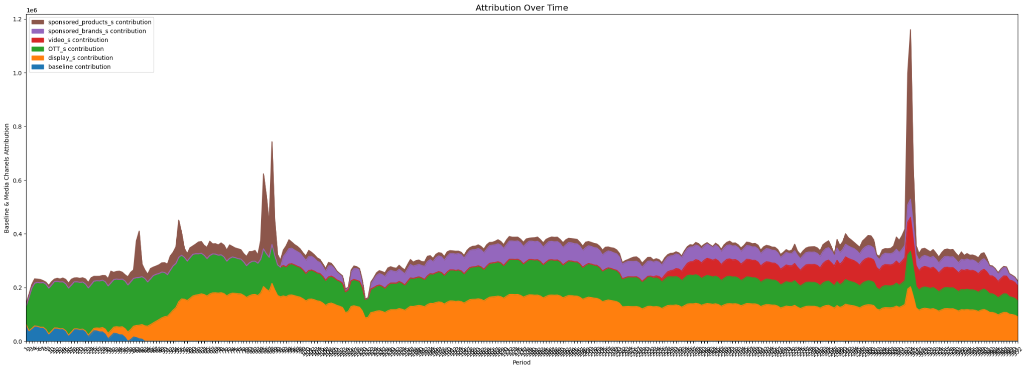
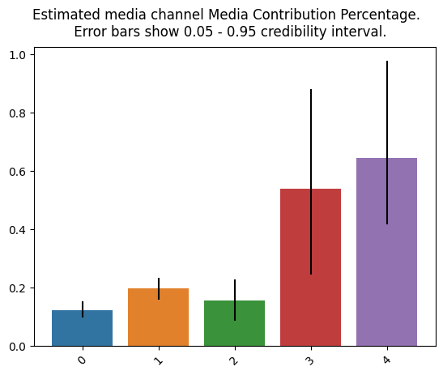
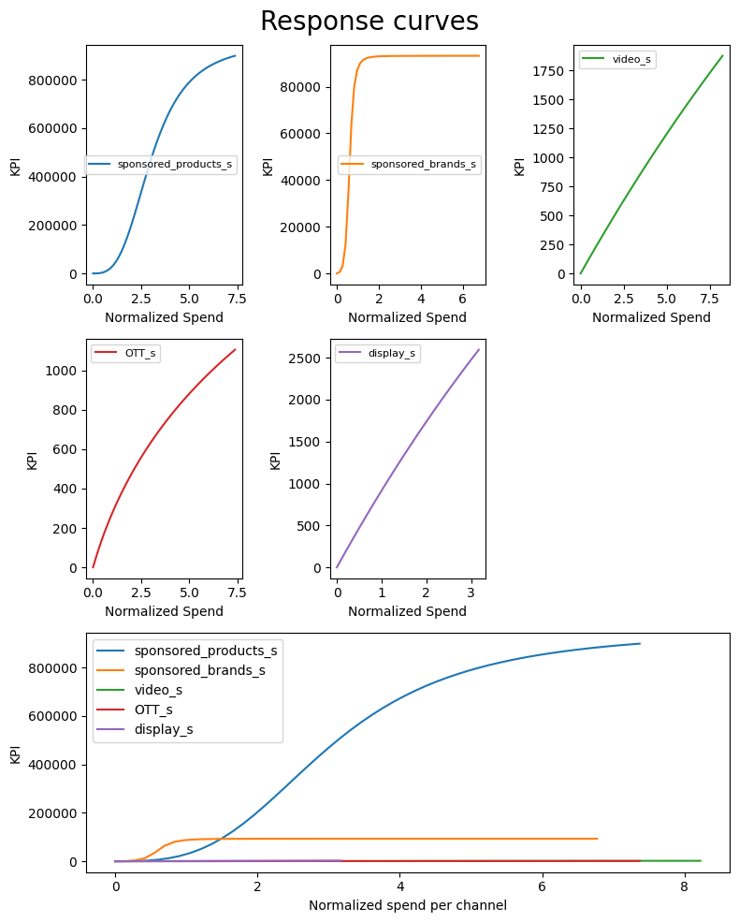
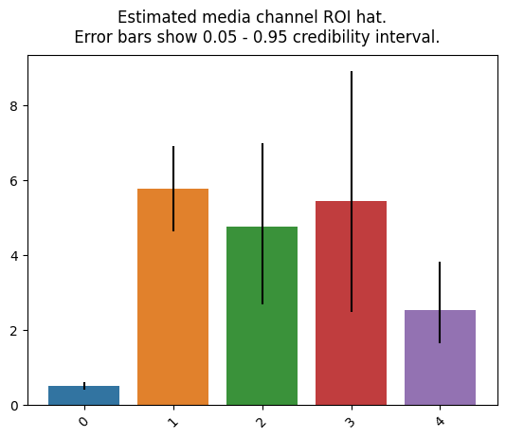
Findings & Insights -
LightweightMMM: Channel Effectiveness
Notes:
The top two charts show the existing contribution of the various media channels over time and on average. From the chart on the top left corner, it can be seen that baseline contribution (the blue part) is minimal, meaning that advertising on Amazon is critical to sales. About half of the sales is attributed to display, which accounts for 38% of the total advertising spend. OTT is also a main contributor, despite only accounting for 15% of total spend. Interestingly, while sponsored products account for 37% of total spend, it is the channel that is contributing the least to sales currently. The respective estimated ROIs of the various channels are shown in the chart on the bottom right corner.
The chart on the bottom left corner shows the response curves of the various channels, meaning how sales would increase when we increase spending. It can be seen that while sponsored products currently has the lowest contribution and ROI as shown in the other charts, increased spending on this channel would generate a much larger response than increased spending on any other channels. Its response curve starts off with a gentle slope but soon climbs up sharply and overtakes all the other channels, the response curves of which level off rather early on. From the response curves, we would predict a reallocation of budget from the other channels to sponsored products.

Slide 13
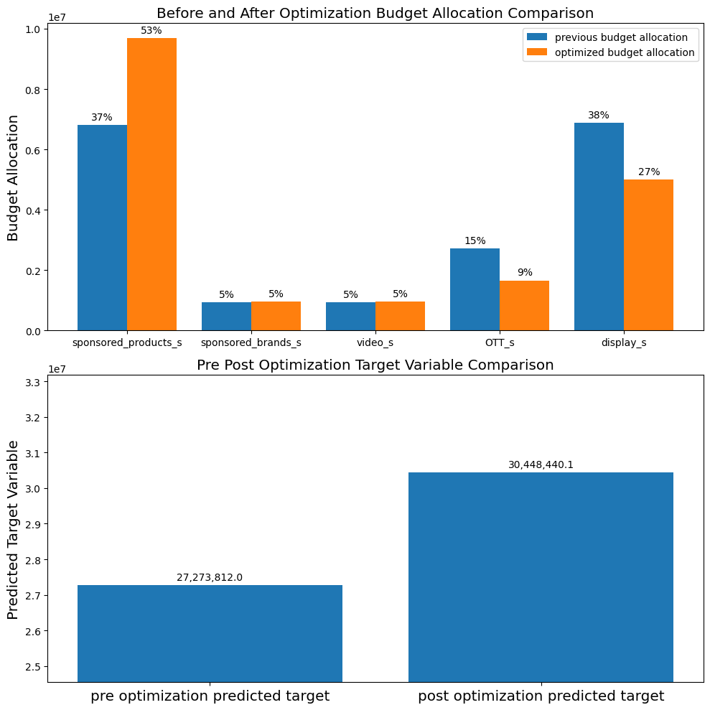
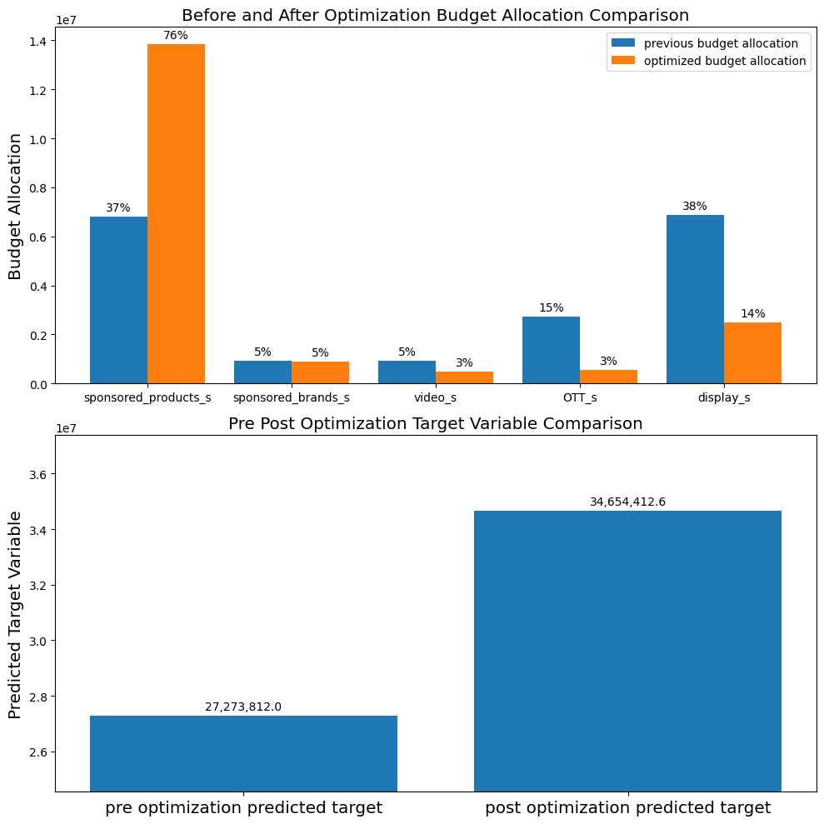
Findings & Insights -
LightweightMMM: Budget Optimization
Initial spending on each channel changed by ±40%
Sponsored products ↑↑
OTT ↓
Display ↓
Sales ↑ 11.6%
Initial spending on each channel changed by ±100%
Sponsored products ↑↑↑
OTT ↓↓
Display ↓↓
Video ↓
Sales ↑ 27.1%
If we allow initial budget allocation to change freely until it stabilizes, 92% should be spent on sponsored products, 5% on sponsored brands and 3% on OTT. This would generate a 41.3% increase in sales.
Notes:
As predicted in the previous slide, we do see a reallocation of budget from the other media channels to sponsored products when applying the model for budget optimization in the last 90 days, assuming the same initial advertising budget.
When limiting how much initial spending on each channel could change to ±40%, the proportion spent on sponsored products increased from 37% to 53%. This is achieved by lowering the proportion spent on OTT from 15% to 9% and that on display from 38% to 27%. The reallocation is expected to increase predicted sales by 11.6%.
When relaxing the limit on initial spending on each channel to ±100%, the proportion spent on sponsored products further increased to 76%, that on OTT down to 3% and that on display down to 14%. The proportion spent on video also decreased from 5% to 3%. The reallocation is expected to increase predicted sales by 27.1%.
If we allow initial budget allocation to change freely until it stabilizes, it is found that 92% should be spent on sponsored products, 5% on sponsored brands and 3% on OTT, but nothing on video and display. This would generate a 41.3% increase in sales.

Slide 14
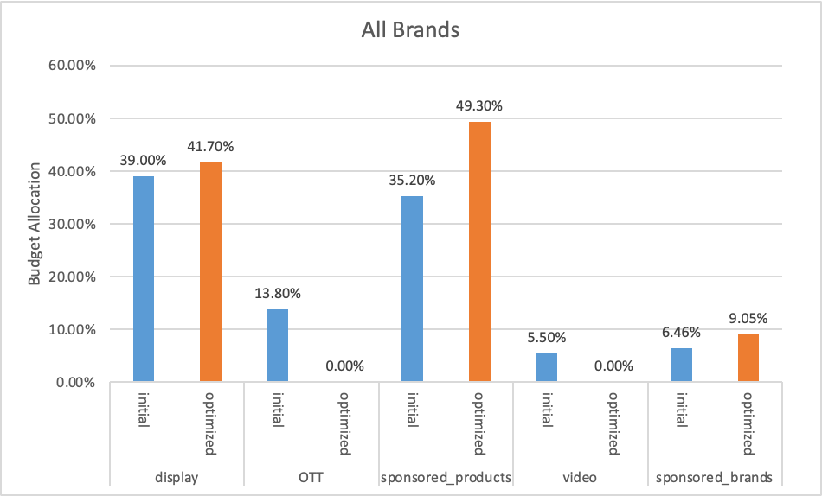
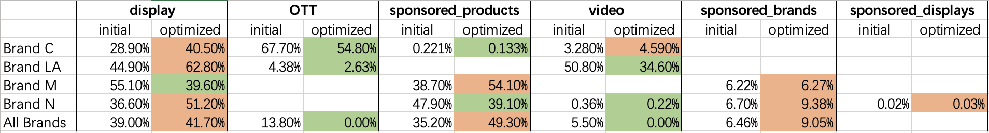
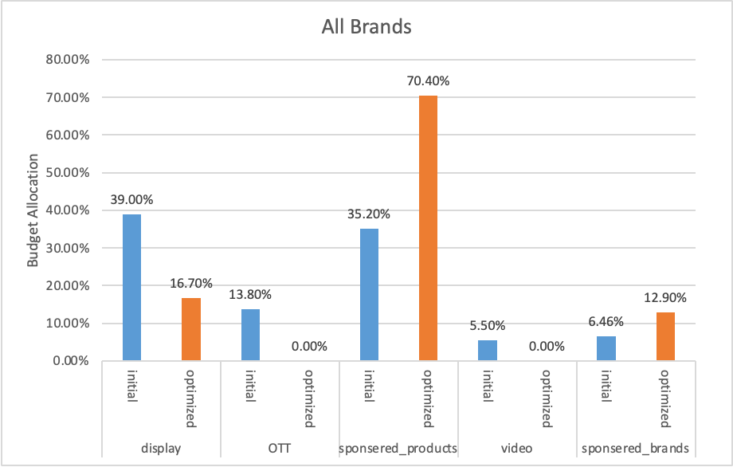
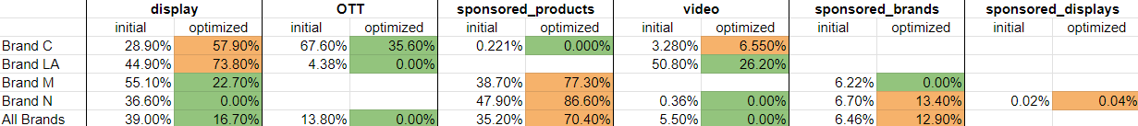
Findings & Insights -
Comparison with Robyn
Robyn
R-square (test): 0.79
Initial spending on each channel changed by ±40%
Budget reallocation indicated by increases & decreases in spending on various media channels under Robyn’s optimization (for all brands combined and four selected brands - C, LA, M, N)
Initial spending on each channel changed by ±100%
Focusing on the optimization result for all brands, Robyn recommends similar budget reallocation as LightWeightMMM: allocate majority of budget to sponsored products, followed by display and sponsored brands
Notes:
We decided to do our main analyses with Google’s LightweightMMM because of its better user friendliness in the Python environment and simpler interpretation for wider application in marketing teams which do not necessarily have a strong statistical background. That said, we recognize that Robyn does have features making it an attractive alternative, including its advanced optimization metrics, detailed adstock and saturation models, the ability to effectively account for annual seasons, holidays and other events specific to a country, and the provision of a range of decision making tools, which together enable Robyn to offer robust and comprehensive solutions.
Therefore, we have also run our data using Robyn to see how its performance and results compare to Google’s LightweightMMM. The above shows the budget optimization results for all brands combined and four selected brands as illustration - C, LA, M, N using a model trained with Robyn, applying the same conditions used in Google’s LightWeightMMM.
Focusing on the optimization result for all brands, it is found that Robyn recommends similar budget reallocation as LightWeightMMM, that is to reallocate the majority of budget to sponsored products, followed by display and sponsored brands. Specific reallocations are as follows -
When limiting how much initial spending on each channel could change to ±40%, the proportion spent on sponsored products increased from 35% to 49%, that on sponsored brands from 6.46% to 9.05%, and that on display from 39% to 42%. This is achieved by lowering the proportion spent on OTT from 13.8% to 0% and that on video from 5.5% to 0%. The reallocation is expected to increase total response by 52.1%.
When relaxing the limit on initial spending on each channel to ±100%, the proportion spent on sponsored products further increased to 70.4% and that on sponsored brands up to 12.9%, that on OTT and video down to 0% and that on display down to 16.7%. The reallocation is expected to increase total response by as high as 146%.

Slide 15
Findings & Insights -
Comparison with Robyn
Bounded: 100%
BRAND C
BRAND LA
Google Lightweight
R-square (test): 0.22
Revenue change: 1.5 (1M)
Sponsored P: 1%
Video: 17%
OTT: 53%
Display: 29%
Robyn
R-square (test): 0.64
Revenue change: 3.3 (190k)
Sponsored P: 0%
Video: 6.6%
OTT: 35.6%
Display: 58%
Google Lightweight
R-square (test): 0.37
Revenue change: 1.8 (1.7M)
Video: 30%
OTT: 15%
Display: 55%
Robyn
R-square (test): 0.36
Revenue change: 1.2(82k)
Video: 26%
OTT: 0%
Display: 74%
No sponsored products spending on optimization period

Slide 16
Findings & Insights -
Comparison with Robyn
Bounded: 100%
BRAND N
BRAND M
Google Lightweight
R-square (test): 0.5
Revenue change: 1.07 (3M)
Sponsored P: 95%
Sponsored B: 5%
Video: 0%
OTT: 0%
Sponsored D: 0%
Display: 0%
Robyn
R-square (test): 0.34
Revenue change: 2.9 (800k)
Sponsored P: 87%
Sponsored B: 13%
Video: 0%
OTT: 0%
Sponsored D: 0%
Display: 0%
Google Lightweight
R-square (test): 0.17
Revenue change: 1.2 (1.7M)
Sponsored P: 18%
Sponsored B: 1%
Display: 80%
Robyn
R-square (test): 0.85
Revenue change: 1.2 (1.1M)
Sponsored P: 77%
Sponsored B: 0%
Display: 23%

Slide 17
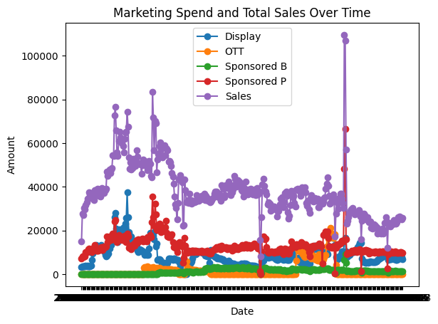
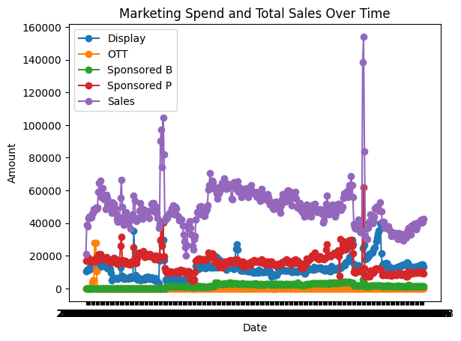
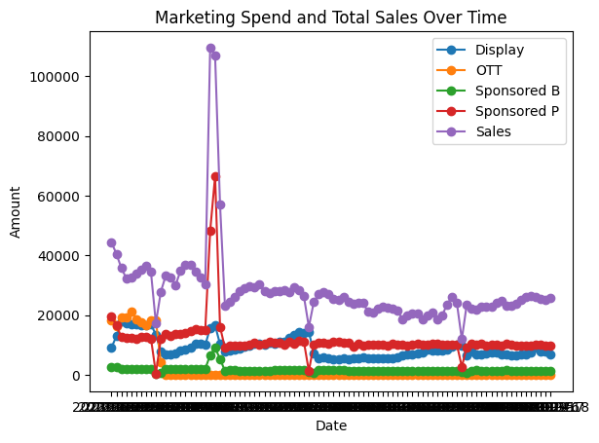
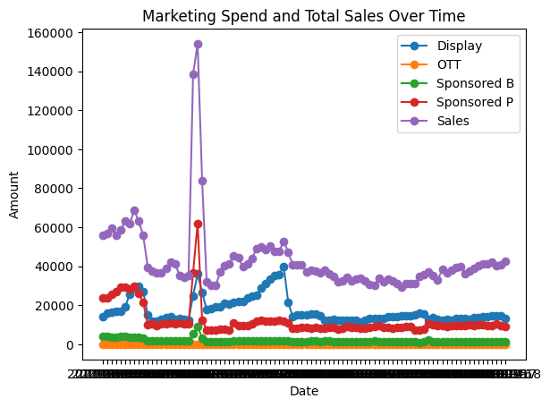
Findings & Insights -
Comparison with Robyn
General trend for M & N: sales follow closely sponsored products for the whole year
Last 90 days: for brand M, Display mirrors sales more strongly
Google Lightweight seems to be more susceptible to being biased by recent trends in the optimization stage (weight this argument with managerial understanding)
360 days
90 days
BRAND N
BRAND M

Slide 18

Recommendations - General advertising strategy
38%
Prioritize spending in platform specific channels
Use Display for specific purpose (i.e. new impactful creative)
Notes:
Prioritize spend on platform specific channels: sponsored products is always recommended by all MMMs as the channel to prioritize. This channel is the most in line with amazon’s marketplace (like ad placement on search is for Google). People go on Amazon primarily to buy a product through a product page. Sponsoring this product page is the most simple way to advertise and we see here it is not only the most simple (makes most sense), but the most effective.
Display: brands heavily invested in Display (38%) but actually ROI is very small. Yet for brand M, we see that some investments in Display were directly correlated with some additional sales for around 2 months. We do not know what happened. We assume a new impactful creative. That is why brands should only consider investing in Display for a specific purpose, like a new creative they know are working very well on other platform right now. Display can be advantageous but for a specific purpose.

Slide 19
Recommendations - How to best use MMMs
Beware of different types of marketing channels (results may behave differently)
Collinearity does not appear to impact the model significantly
Custom parameters is minor
Choose optimization period containing max # of channels
Use your managerial understanding
Understand your data (what type of transformation is appropriate)

Slide 20

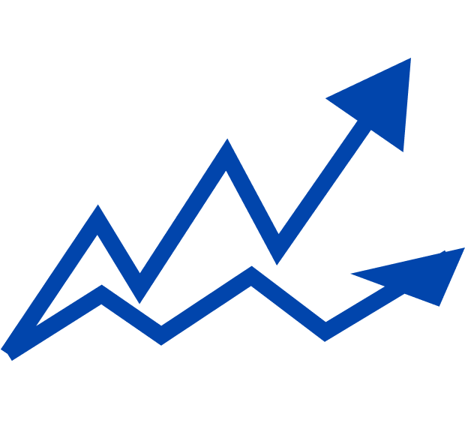
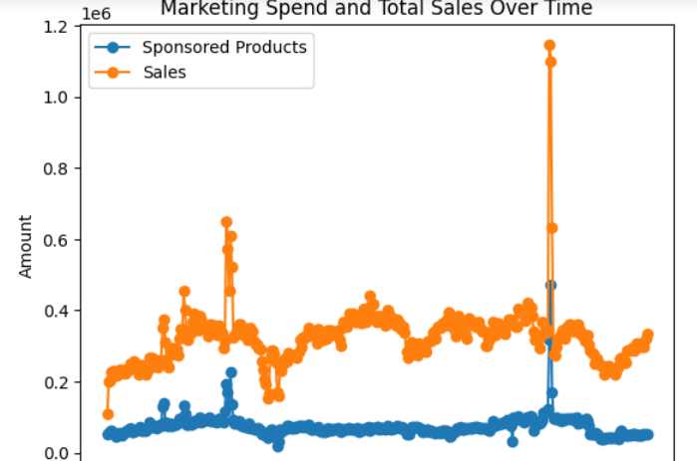
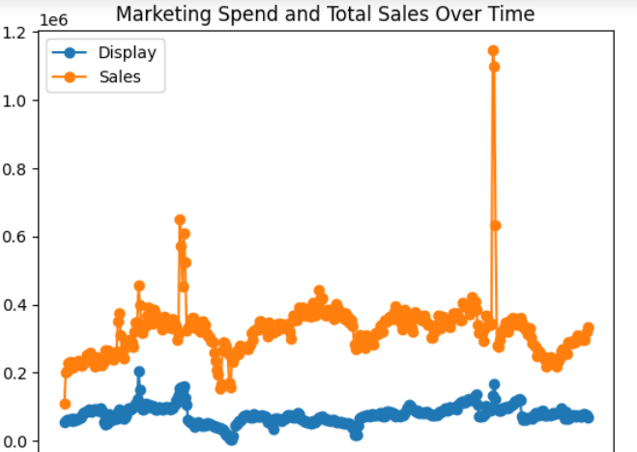
Recommendations - Understand your data
 | Remove Sponsored Product (37% of total spend) |  |  |  | Remove Display (38% of total spend)
 | In sample model fit |  | Out of sample prediction |  | In sample model fit |  | Out of sample prediction
 | R square | MAPE | R square | MAPE | R square | MAPE | R square | MAPE
adstock | 0.762 | 9.4% | 0.86 | 4.3% | 0.845 | 7.7% | 0.737 | 9.2%
hill_adstock | 0.838 | 6.9% | 0.17 | 12.9% | 0.921 | 4.888% | 0.889 | 6.3%
Keep channels consistent with promotion platform
Beware of channels’ spending weights
Applying appropriate transformations is crucial
Notes:
We decided to assess the impact of the channels to most invested in (Sponsored Products and Display) by removing out of the model. Results we found were interesting.
Using the Hill Adstock transformation on the data and removing sponsored product, the out of sample prediction r square is extremely low (17%). However, when using Hill Adstock and removing Display, the out of sample prediction r square is the best we ever had on any model (89%).
We assume that this phenomenon originates from the intrinsic distribution of the channels and the way they operate in the real world. Sponsored Products follows very closely the sales, and maybe explains the sales the most. So when removing it from the sample, the r square drops a lot. It did not drop as much when applying just adstock because we believe that applying the hill transformation only applies to Sponsored Products. All other spending in channels are quite slow and have not reached their max spending potential to receive the hill transformation. SO using hill adstock without sponsored products misrepresents the data.
When removing Display, we find better results because we assume that most other channels behave like sponsored products, they are Amazon specific. Display is the only one that works kind of like print/out of home advertising or tv. You see a nice ad and it stays in your mind, so you need adstock function to account for the purchase after some time after seeing that ad (explains why adstock transformation without sponsored product, r square is high, because display now that sponsored products has been removed, accounts for more than 50% of the spend, and spend will be shaped by its distribution which conforms adstock distribution). So when removing display, the data remains with a distribution that works in a similar fashion as other channels, removing display is like removing some noise in the data as this channel does not behave the same as others, and that is why we found the best r square.

Slide 21
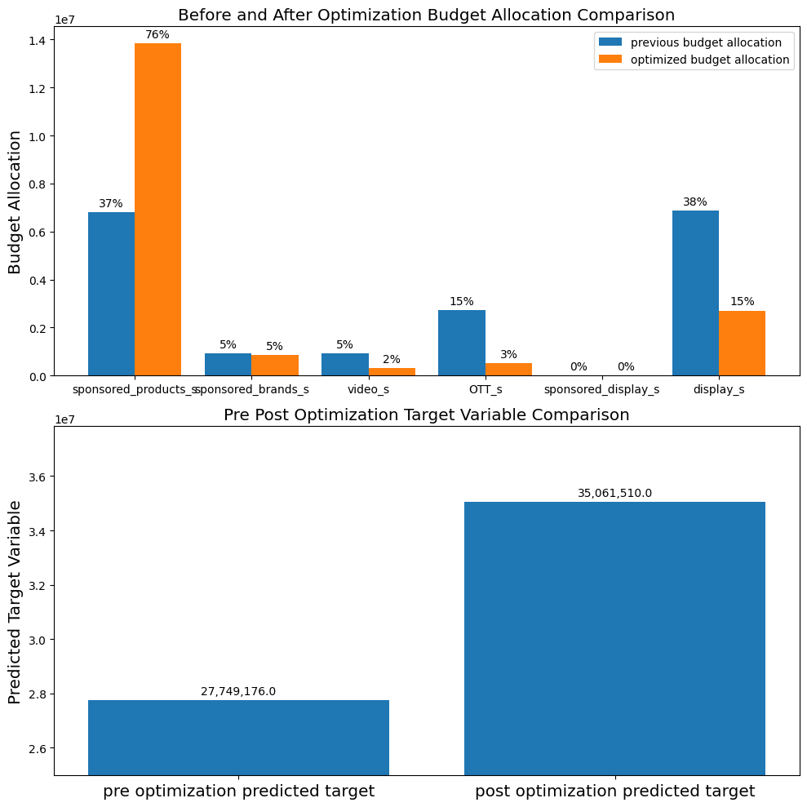
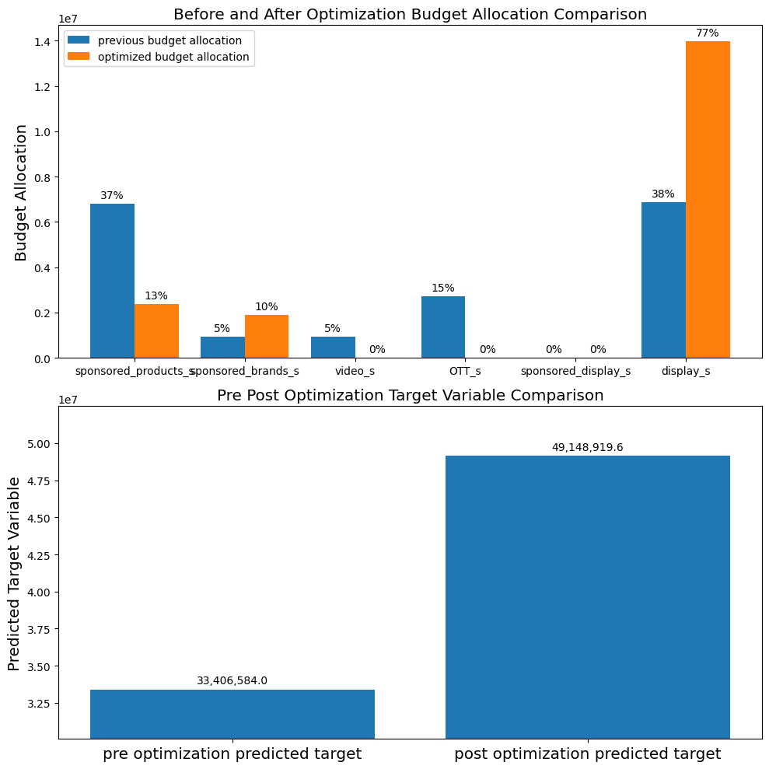
Recommendations - Understand your data
Adstock vs. Hill Adstock
Misrepresentation
of spend behavior
Hill_Adstock
Adstock
Notes:
All channels present a small adstock effect so just on this basis, Display becomes more interesting to invest into. But the hill function captures an additional effect that is much more explained by other channels (maybe why more channels are recommended when using Hill_adstock and not just Adstock)

Slide 22
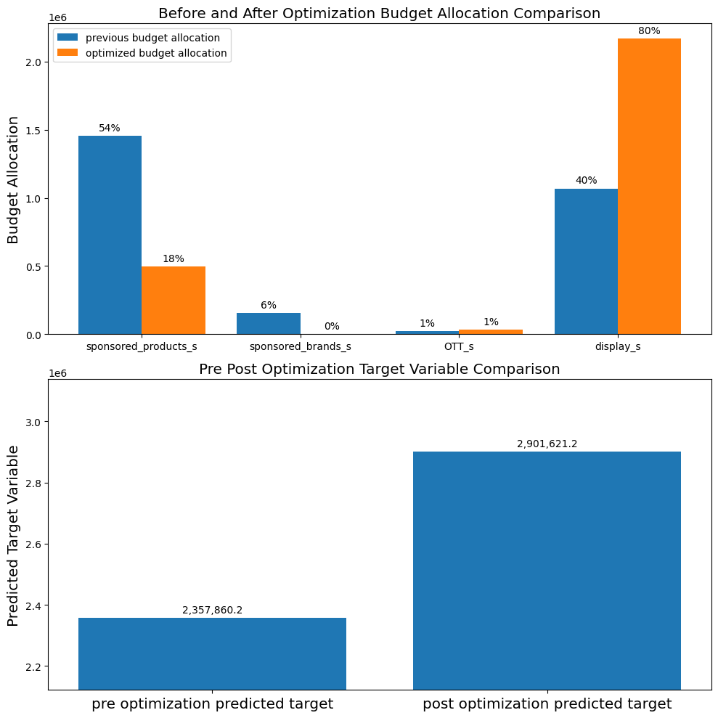


Recommendations - Managerial understanding to best optimize results
VS.
Brand M
Make your analysis on both models
Check for differences or similarities -> more insights will be derived from this and will allow managerial judgment to be used for interpretation
Use Google for best simplicity/effectiveness but beware of opti results when R square < 20%
Drastic changes in spend should be investigated
Google Lightweight is biased by last 2 months of a Display advertising working well (use boundaries accordingly)

Slide 23


Limitations and Further Research
PROJECT
MMM
Results are specific to advertising on Amazon
Apply different functions to different channels (varying behavior)
Results depend on the type of products and brands
Explore effect on different market segments
Include more control variables, e.g. competitor sales, offline advertising, economic performance, etc.
Geo level granularity

Slide 24
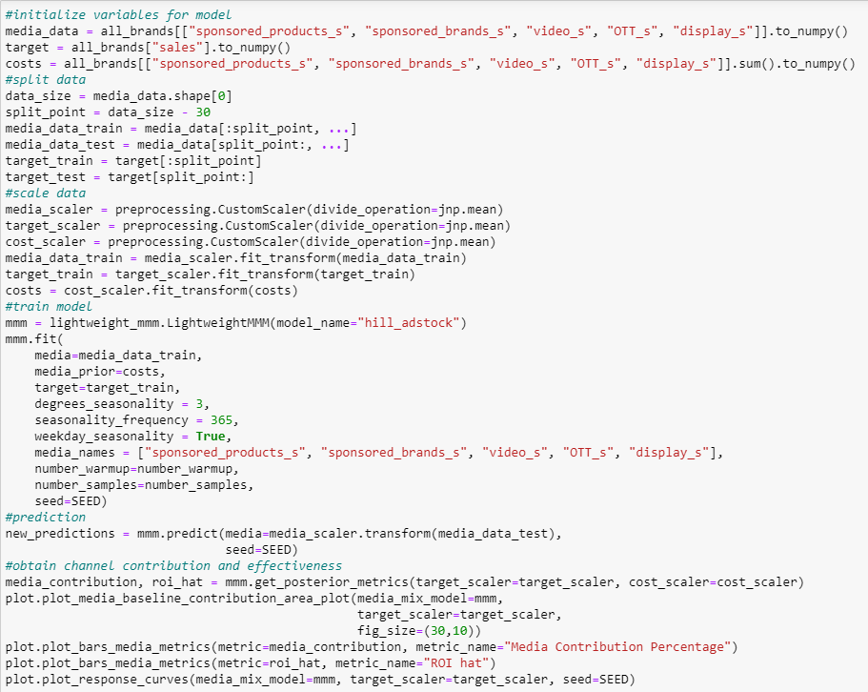
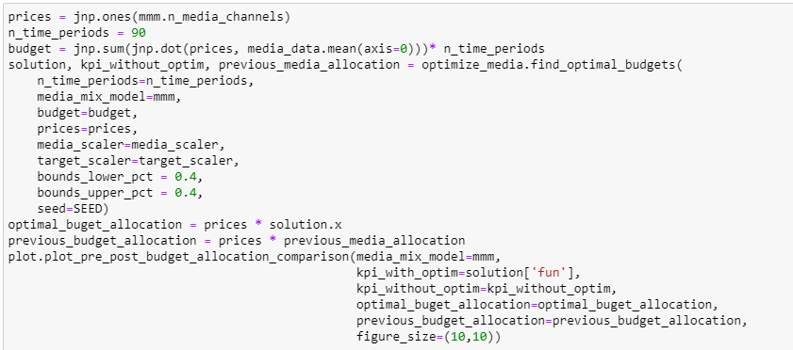
Appendix
Google Lightweight: https://github.com/google/lightweight_mmm
Model Training
Budget Optimization
SAMPLE CODES

Slide 25
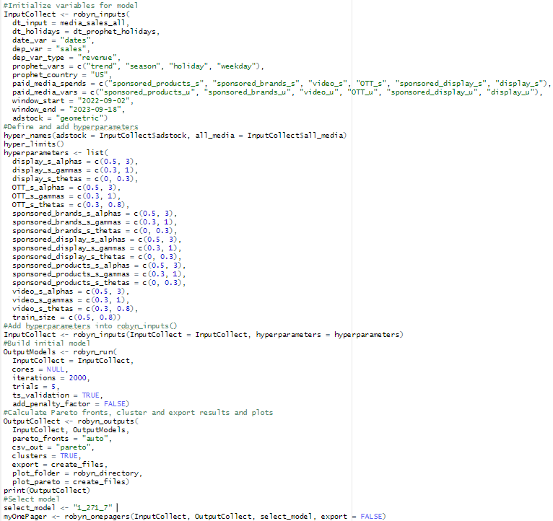
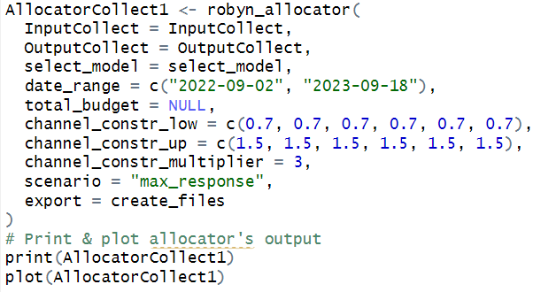
Appendix
Robyn: https://facebookexperimental.github.io/Robyn/
Model Training
Budget Optimization
SAMPLE CODES

Slide 26
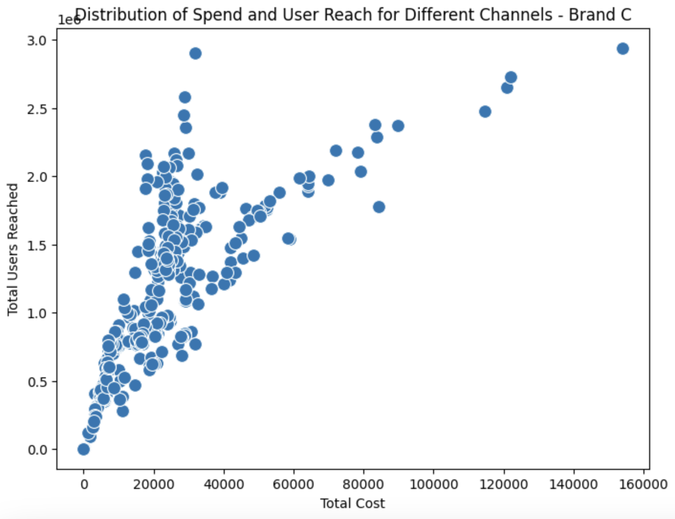
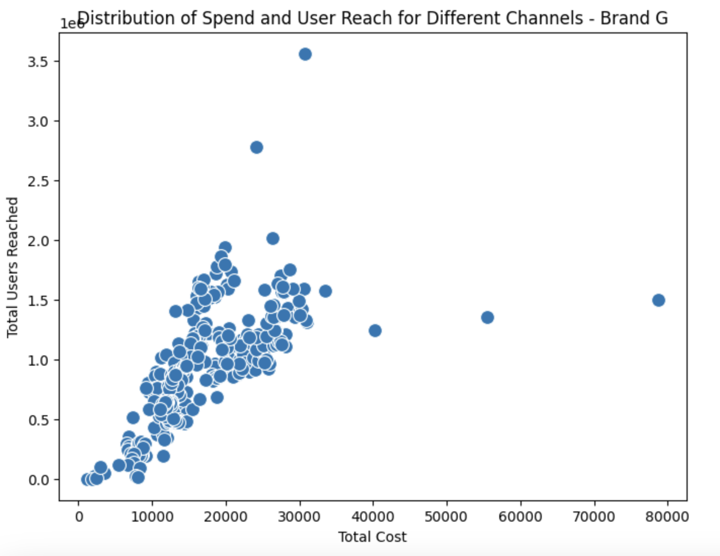
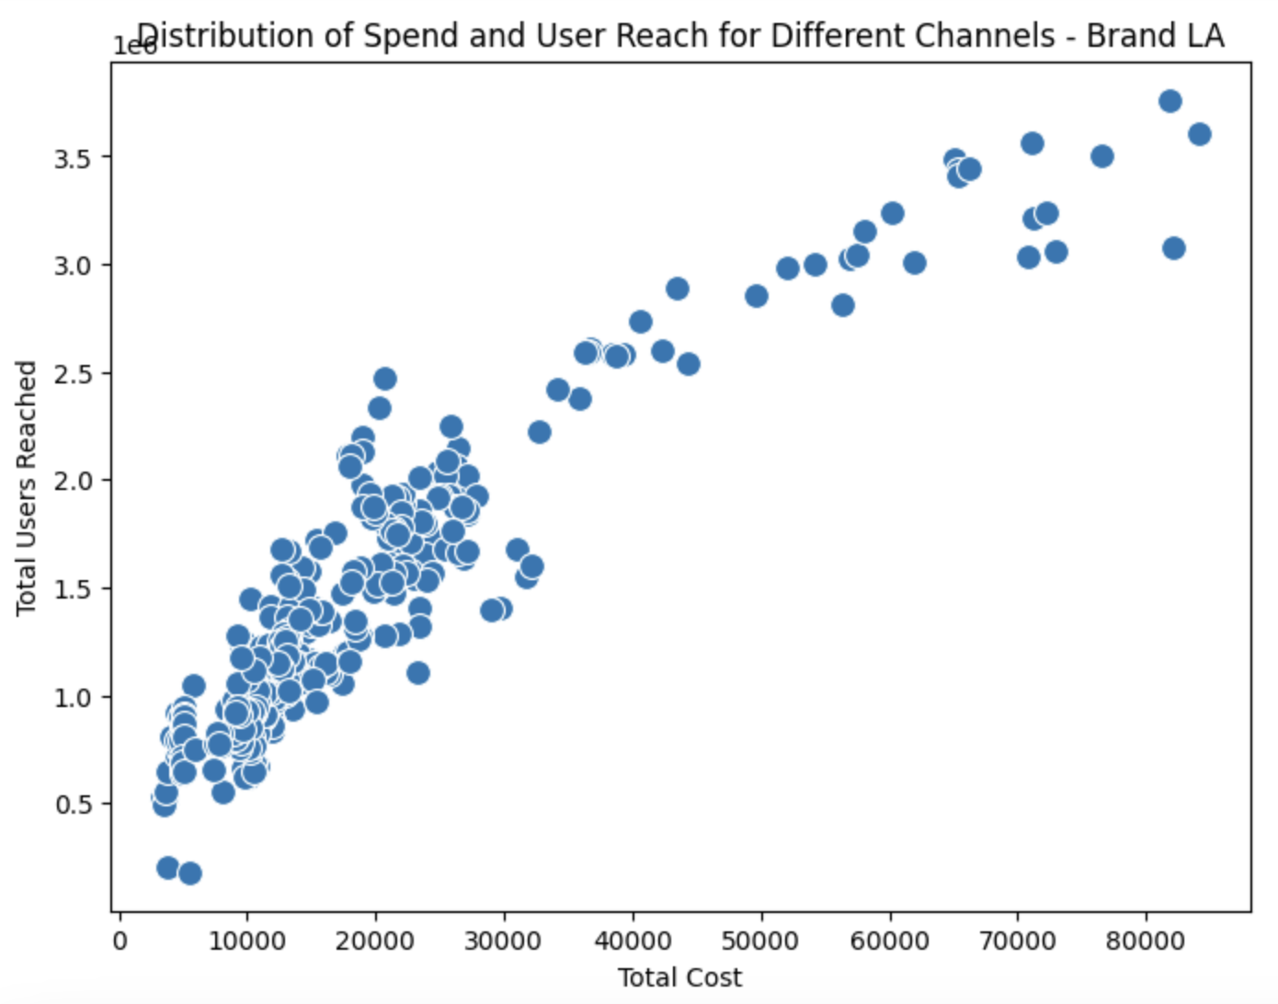
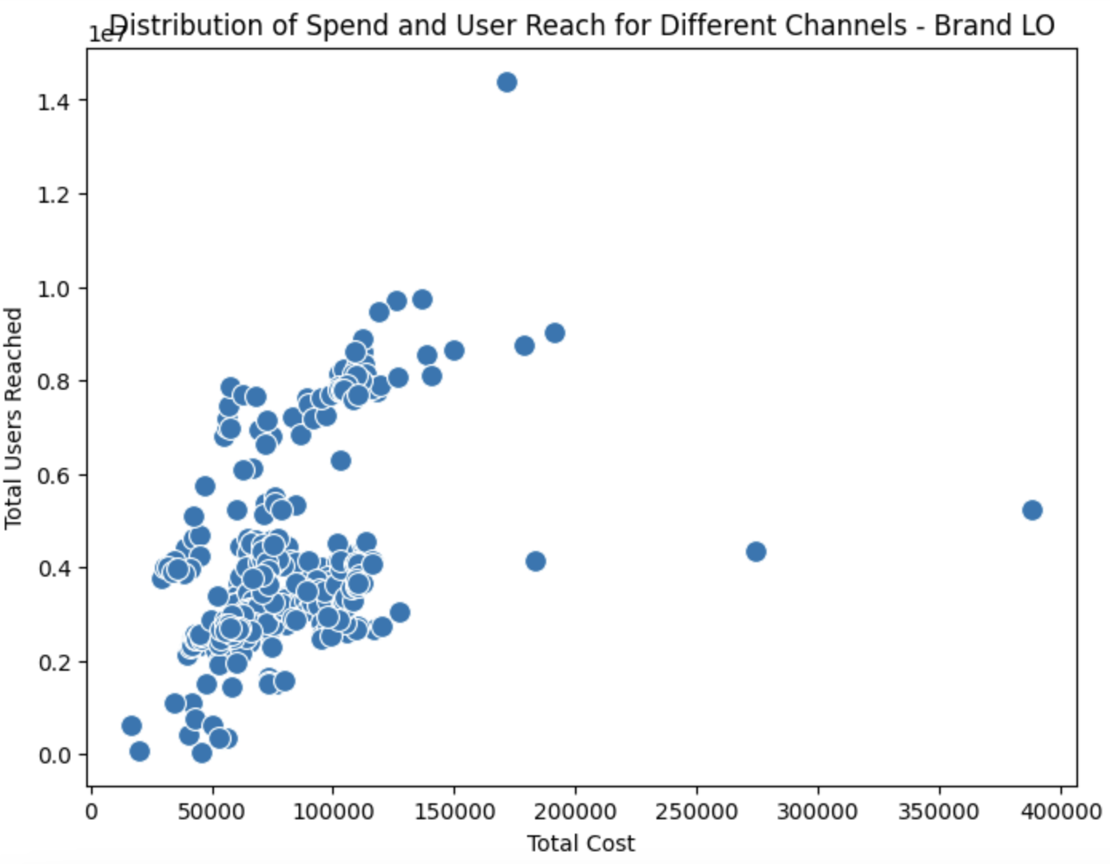
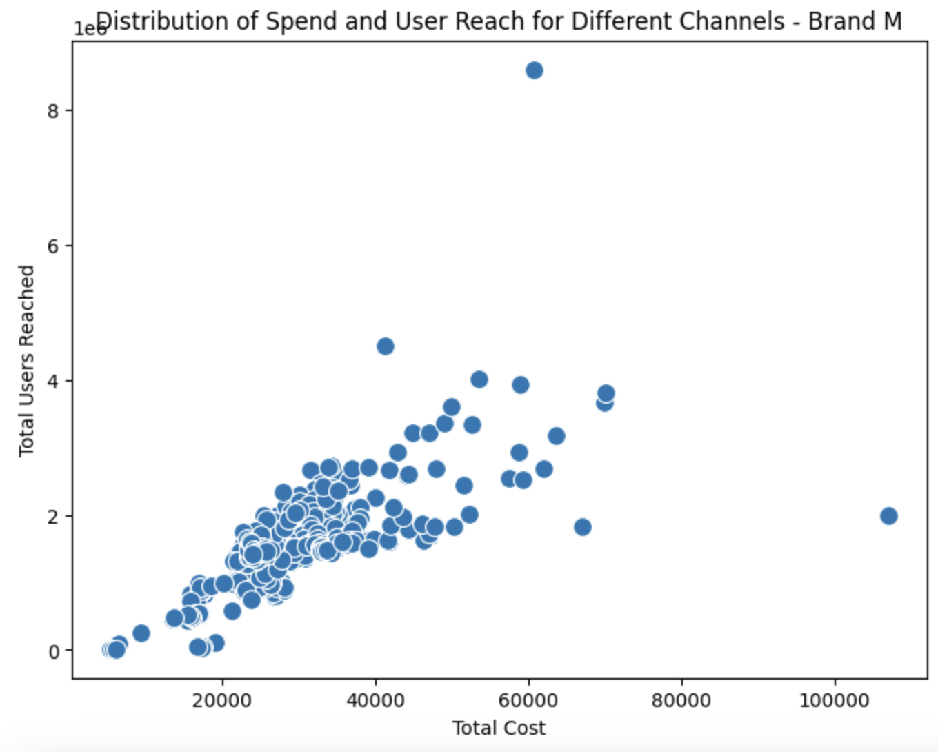
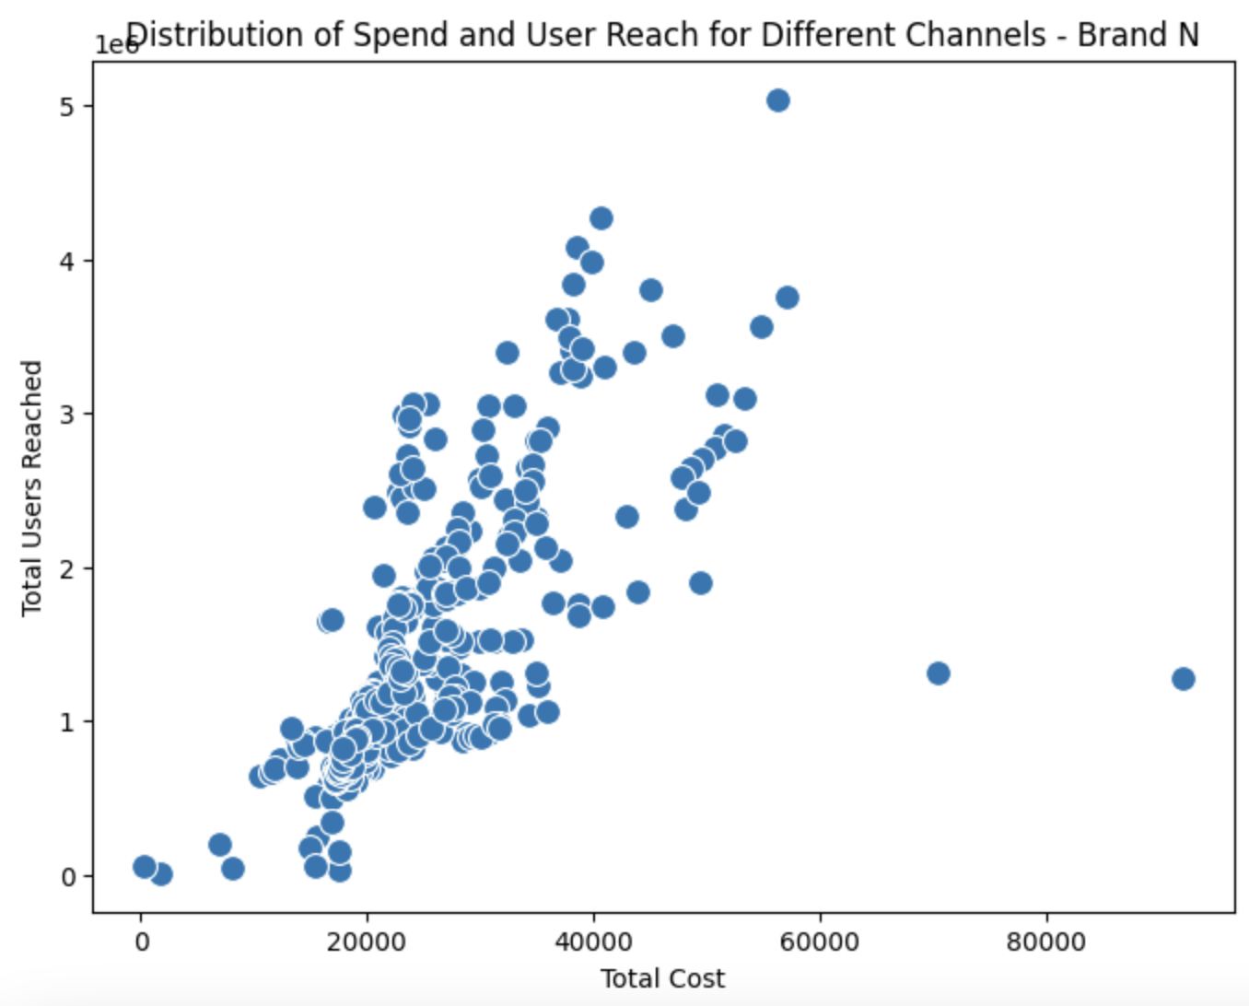
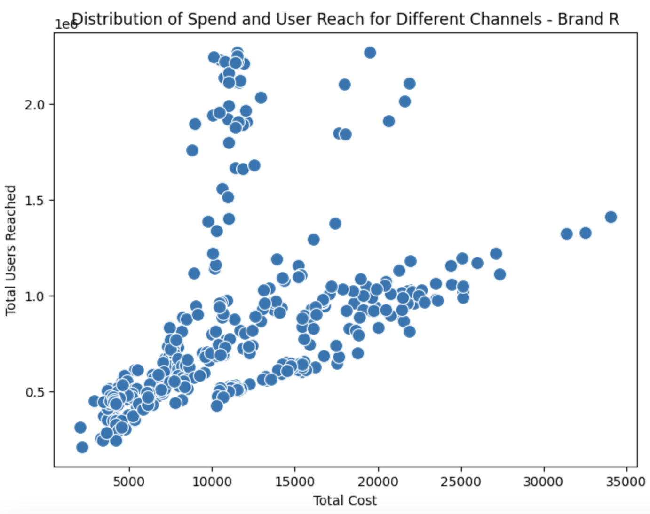
Appendix
Additional Data Visualization - Distribution of Spend and User Reach by brands

Slide 27
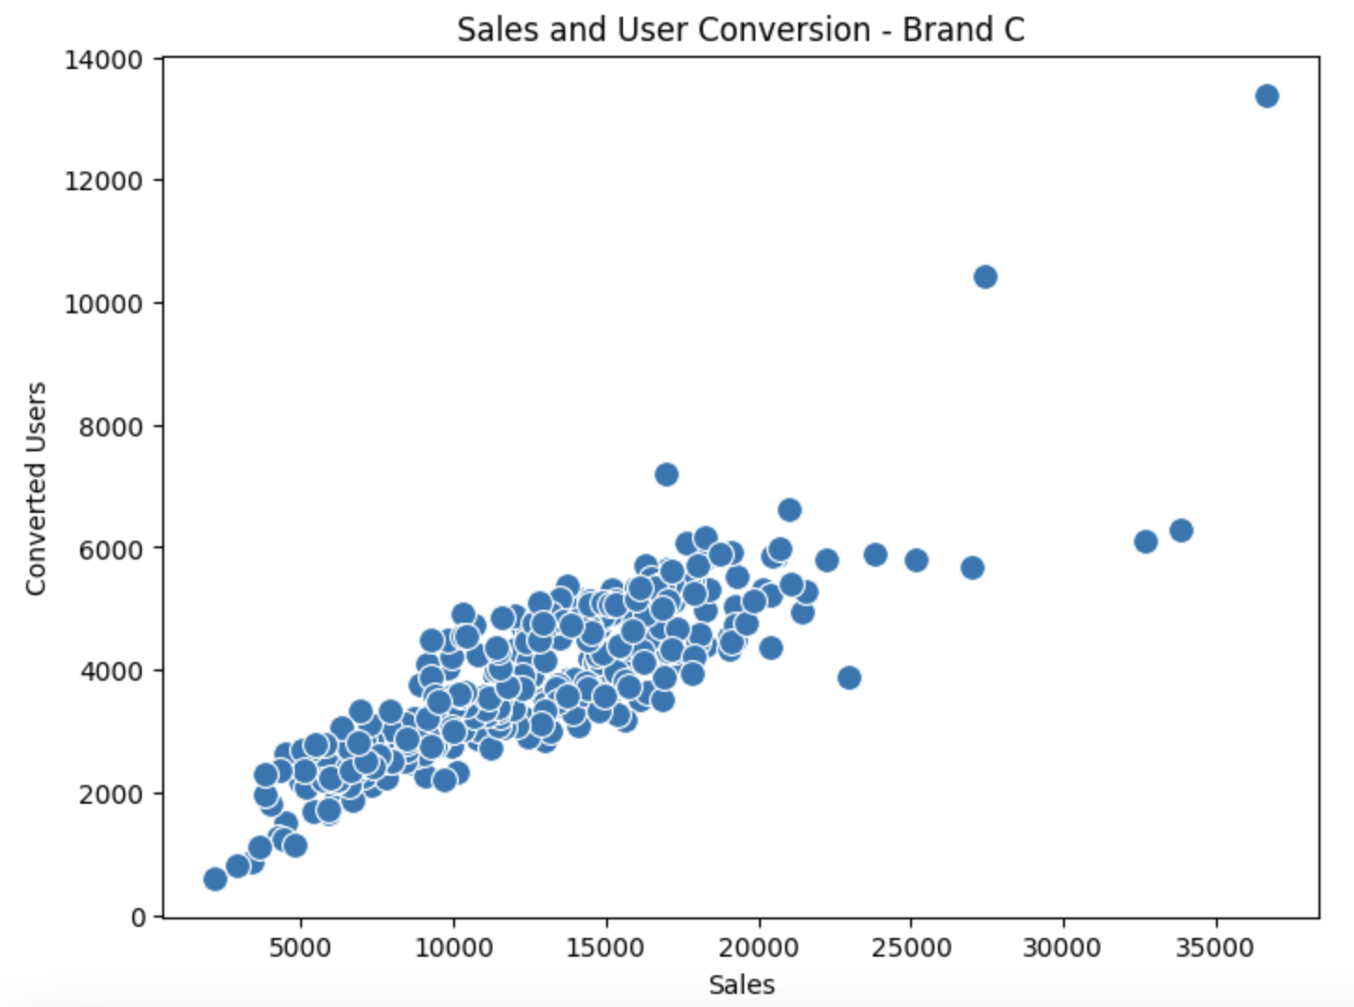
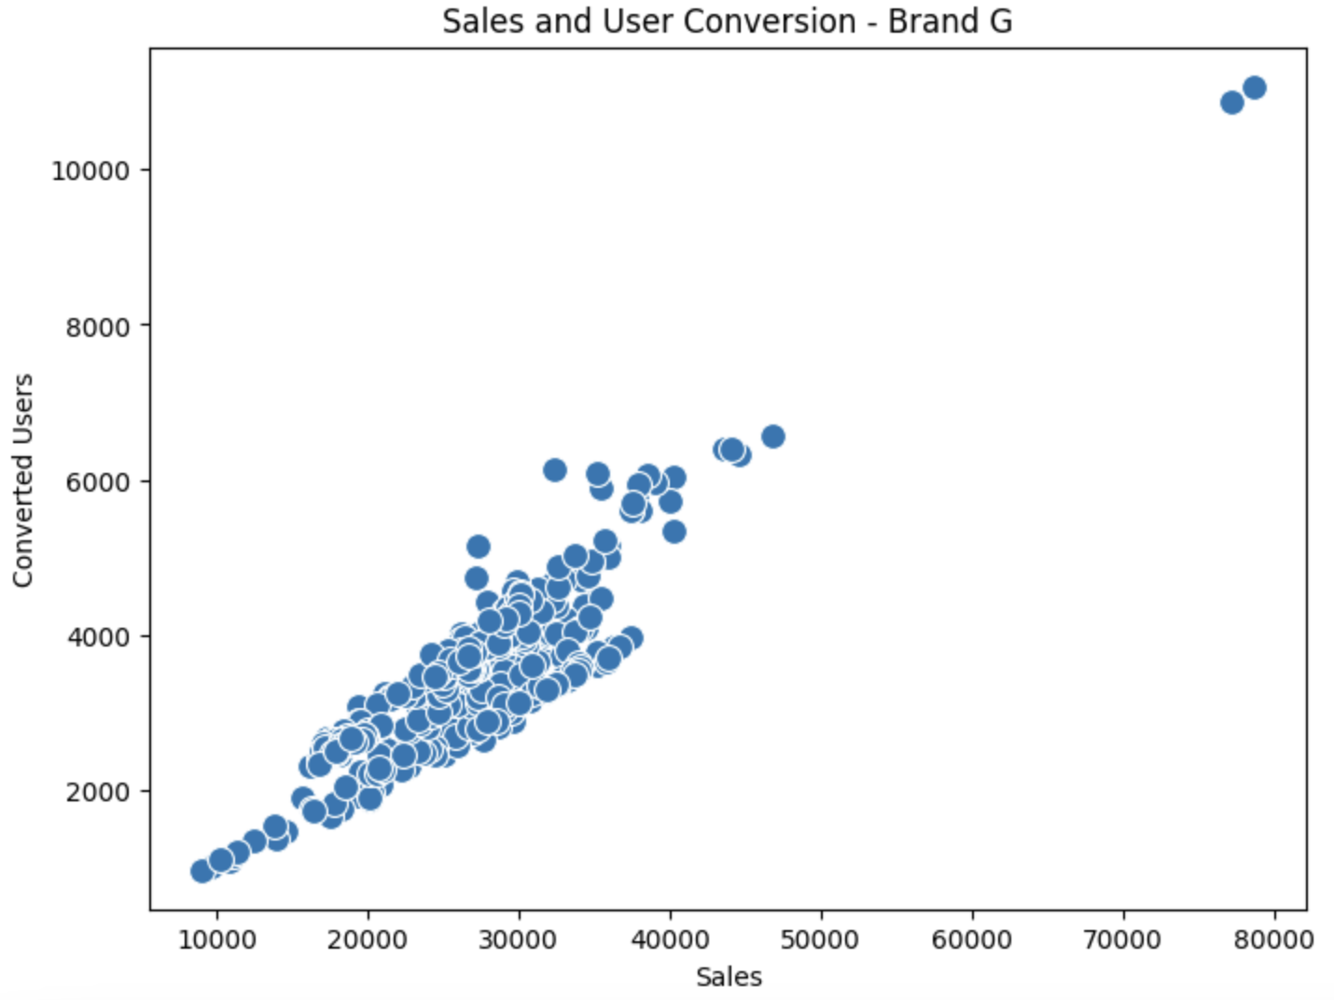
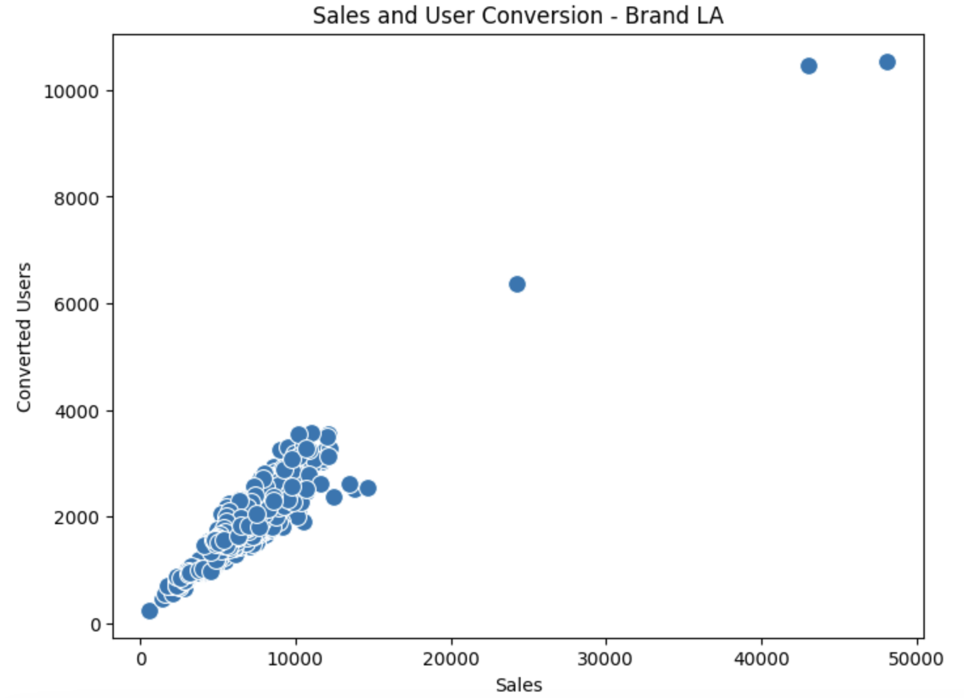
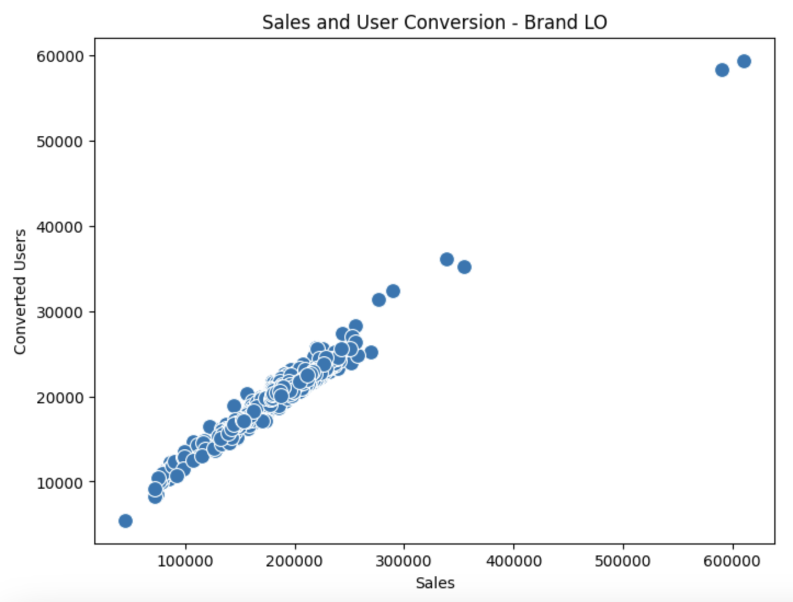
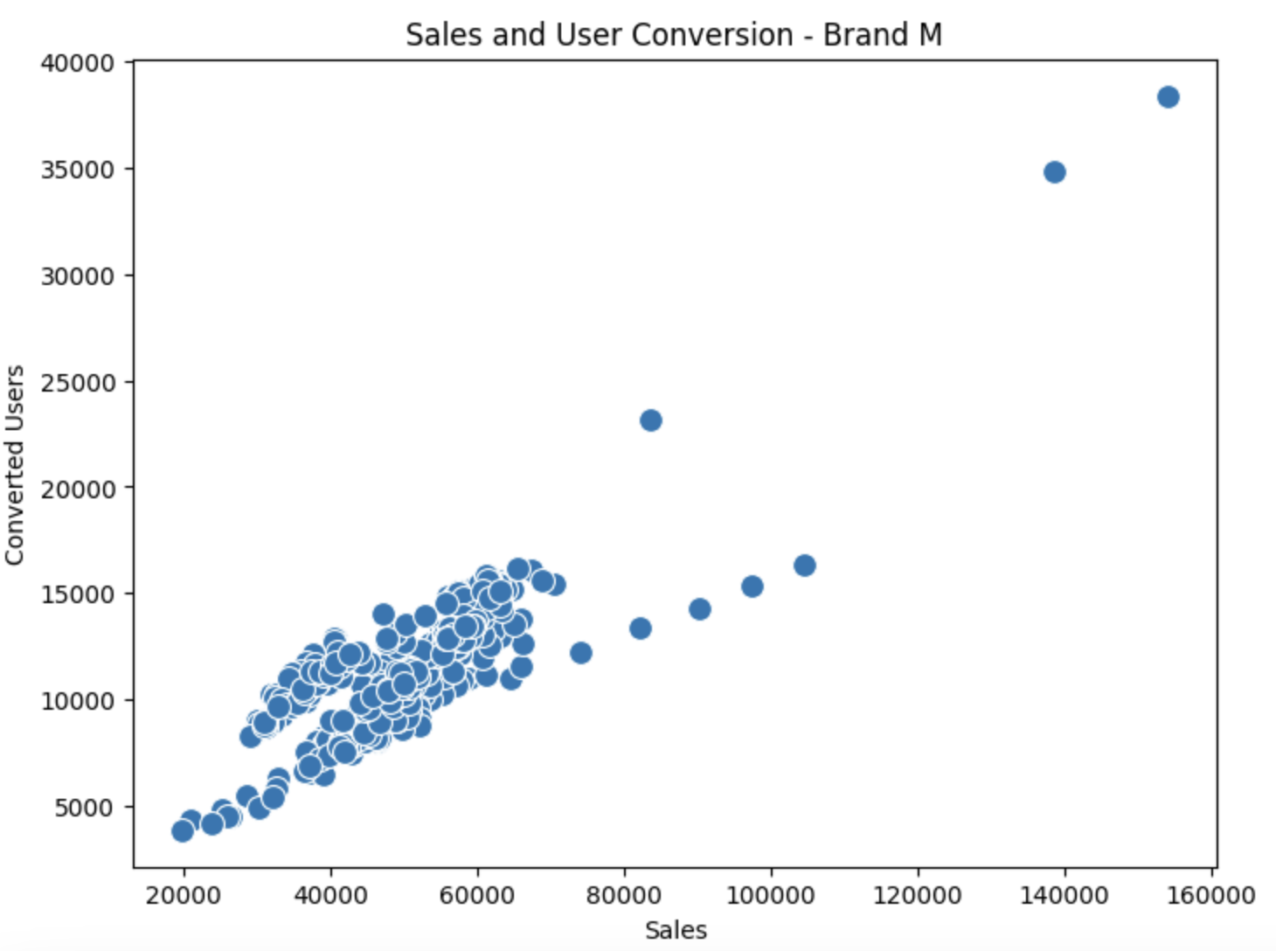
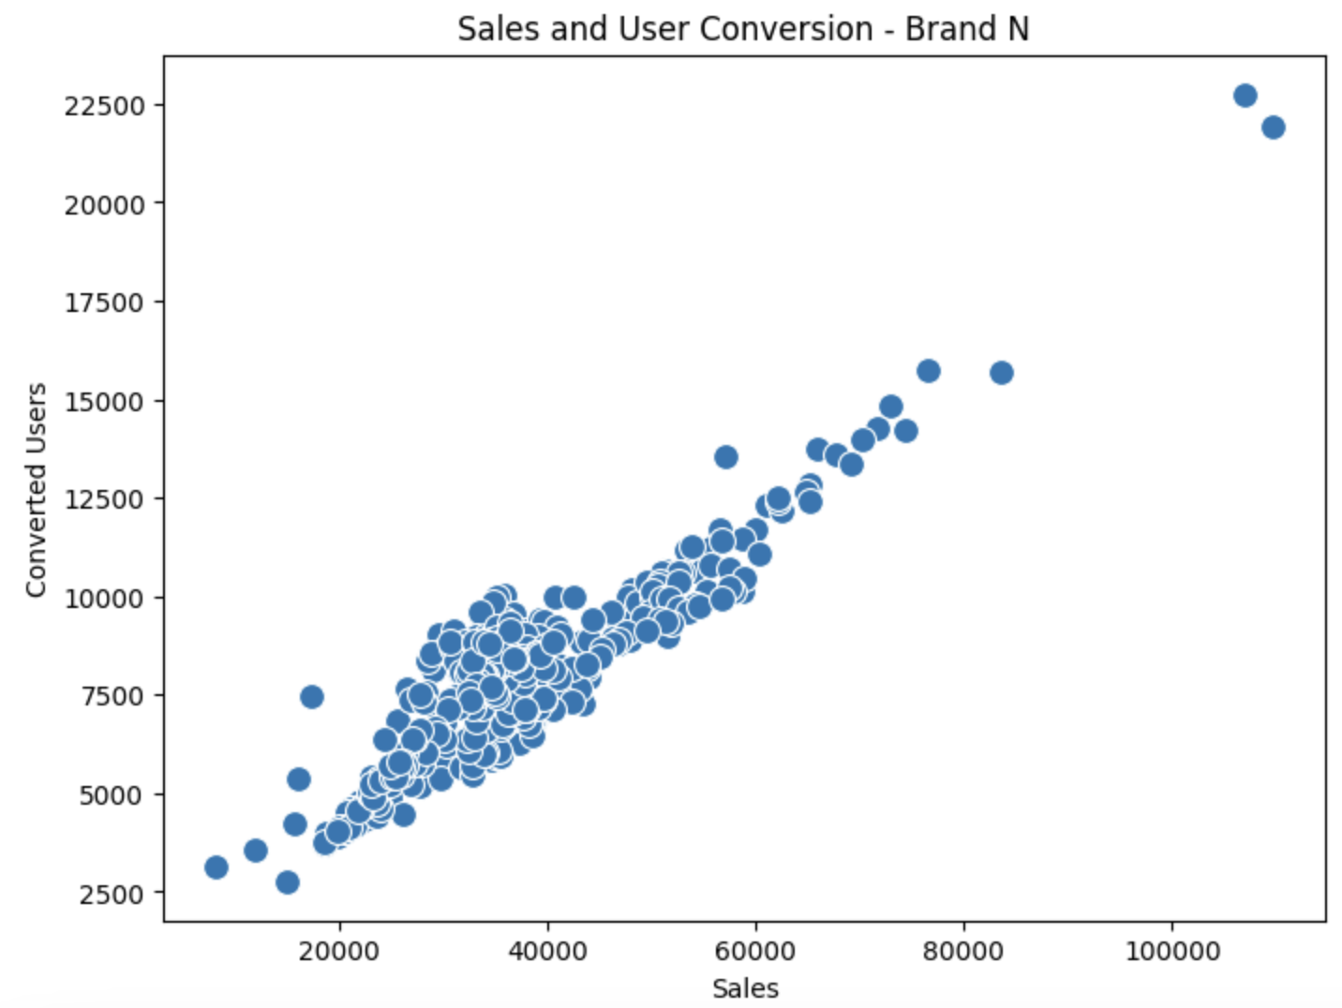
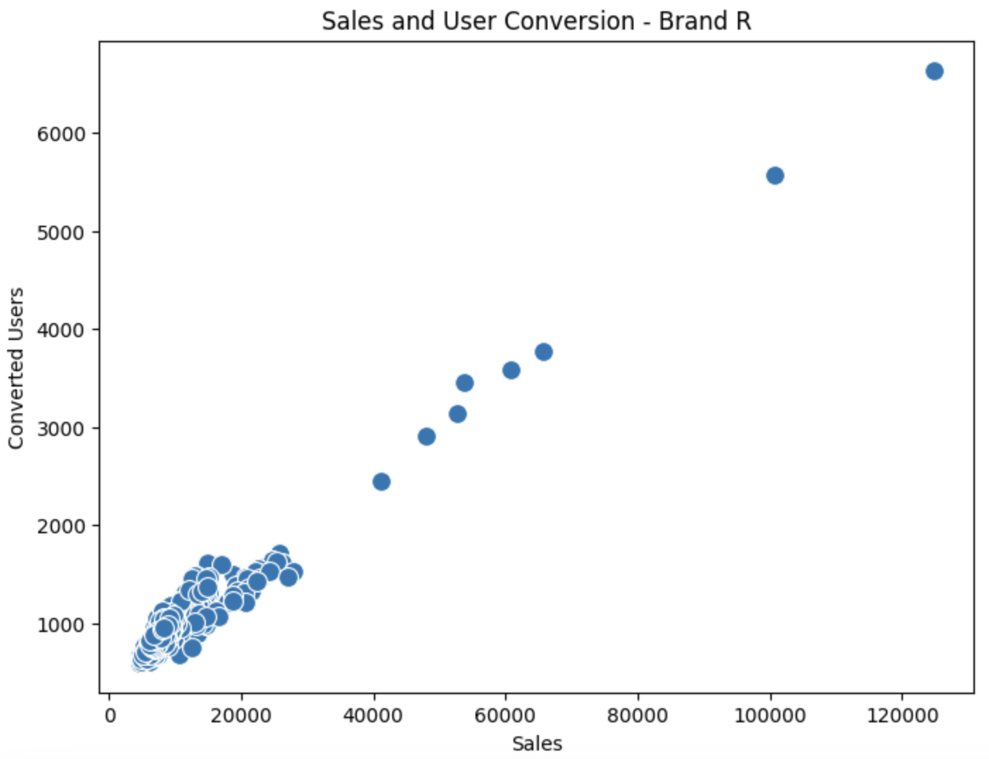
Appendix
Additional Data Visualization - Distribution of Sales and User Conversion by brands

Slide 28




Appendix
Additional Data Visualization - Sales and Spends over time by brands

Slide 29




Appendix
Google LightweightMMM Optimization Outputs
Brand C
Brand LA
±40%
±100%
±40%
±100%

Slide 30




Appendix
Google LightweightMMM Optimization Outputs
Brand M
Brand N
±40%
±100%
±40%
±100%

Slide 31


Appendix
Robyn Outputs
All Brands
±40%
±100%

Slide 32


Appendix
Robyn Outputs
Brand C
±40%
±100%

Slide 33


Appendix
Robyn Outputs
Brand LA
±40%
±100%

Slide 34


Appendix
Robyn Outputs
Brand M
±40%
±100%

Slide 35


Appendix
Robyn Outputs
Brand N
±40%
±100%

